Slide 1
List of Appendices

Slide 2
Table of Contents
Appendix A - Executive Visioning Workshop P. 3
Appendix B - Change Readiness Assessment P. 95
Appendix C - Current Applications Assessment P. 120
Appendix D - Supply Chain Assessment Summary P. 133
Appendix E - Consolidated Interview Data P.149
Appendix F - Consolidated Store Visit Data P.156

Slide 3
Appendix A
Executive Visioning Workshop

Slide 4
Agenda
Time Description Presenter
7:30 Breakfast
8:00 Welcome Shai Verma
8:10 Introductory Comments Larry Latowsky
8:30 Supply Chain Best Practices David Stevens and Harley Rodin
9:30 McKesson Presentation Doug Wilson
10:00 Break
10:15 Project Casper Supply Chain Vision Rui Martins and Shai Verma
11:15 Change Management Presentation Nancy McTavish
12:00 Lunch
12:45 Metro AG Video Jane Smythe
1:00 Breakout Sessions Al Pinington
1:30 Breakout Session Debrief Lino Casalino
3:15 Break
3:30 Supply Chain Vision Discussion Lino Casalino
5:30 Close Shai Verma

Slide 5
Executive Visioning Participants
Katz Group Canada
Larry Latowsky, President and CEO
Mike Martin, CFO
Terry Buckley, President Herbie’s and CMO
Barry Elliott, President Rexall
Andrew Parkes, President, PharmaPlus
Peter Davidson, VP HR
Grant Schwartz, VP IT
Gersh Sone, VP Pharmacy
Bruce Moody, VP Operations, PharmaPlus
Paul Dale, VP Operations, Herbie’s
Al Wilkie, VP Operations, Rexall
Sue McCabe, VP Private Label
Eugene Gidaro, VP Finance
Chris Taylor, VP Merchandising
Jonathan Alpert, VP Merchandising
Brad Robbins, Chief Marketing Officer
Norm Puhl, Vice Chairman
Paul Marcacio, Katz Group
Rui Martins, Director, Supply Chain
McKesson Canada
Doug Wilson, VP Customer Solutions
Don Nicholson, National Accounts Manager
Graham Hardie, Director Sales Ontario
Jeff Faria, Director Operations Ontario
IBM
David Stevens, BCS Supply Chain Lead Partner
Lino Casalino, BCS Retail Lead Partner
Jane Smythe, BCS Client Relationship Leader
Harley Rodin, Pharma Retail Industry SME
John Woollett, Business Transformation SME
Nancy McTavish, Change Management Lead
Alan Pinington, Supply Chain Lead Consultant
Angelo Cina, Supply Chain Consultant
Shai Verma, Project Manager

Slide 6
Objectives
Provide an executive level awareness of supply chain best practices
Develop a common understanding of the draft Vision to be presented today and a chance to discuss its implications
Discuss the options available to KGC in terms of achieving the Vision
Solicit executive opinions on how to improve the Vision
No decisions are being made today
Your Objectives?

Slide 7
Ground Rules
All players are equal
All ideas are valuable
Start on time, end on time, return from breaks on time
Cell phones and pagers on SILENT
  Phone in the foyer
Minimize side conversations
Minimize trips outside of room
Only one person speaks at a time
Stay in PRESENT TIME
Enjoy
Anything else?
Washrooms:
Exit board room, turn right, exit glass double doors, turn left, exit glass double doors, turn right down hall way, continue about 10 metres:
Females on the left
Males on the right
Emergency Exit:
Exit board room, turn right, exit glass double doors, turn left, exit glass double doors, turn left past elevators on left hand side

Slide 8
Katz Group Canada Business Strategy
Larry Latowsky

Slide 9
Supply Chain Management:
An Overview of eBusiness on Demand in the Supply Chain
David Stevens

Slide 10

Remember the Law of Supply and Demand?
…well, Demand Won!
Notes:
This is an evolution, and yet it's a fundamental shift in the way the best run companies are thinking about:
Allocating precious resources...
Structuring processes...
Competing...
And interacting with partners, employees and customers.
It's a response to a world that's more volatile than ever before.
This isn't just about finding new ways to manage through a weak economy.
On demand modes of operation apply whether the economy is speeding up or slowing down.
In fact, growth can drive as many challenges as a downturn to a supply chain, to customer relationships, or to the resilience of your underlying infrastructure.

Slide 11
The excitement in the Retail Value Chain…
Develop Vision and Strategy
Supply Side
Manage Supply Chain
Manage Products& Services
Manage Brand
Manage Channels
Manage Customer
Manage Relationships
Customer Service
Manage Knowledge
Demand Side
Manage Financials
Manage Information Resources
Manage Human Resources

Slide 12
But, today, YOU will make Supply Chain exciting!
Develop Vision and Strategy
Supply Side
Manage Supply Chain
Manage Products& Services
Manage Brand
Manage Channels
Manage Customer
Manage Relationships
Customer Service
Manage Knowledge
Demand Side
Manage Financials
Manage Information Resources
Manage Human Resources

Slide 13
So, what is the Supply Chain?
  Manage Supply Chain
  Inbound Logistics
  DC Operations
  Reverse Logistics
  Outbound Logistics
  Logistics Vendor Management
  Customer Service
  Manage Products and Services
  Forecasting
  Planning
  Sourcing
  Order Management
  Product Development
  Vendor Management
  Services Development
  Pre/Post Allocate
  Inventory Management
  Cost/Price Management
  Promotions Management
  Replenishment
Develop Vision and Strategy
Supply Side
Manage Supply Chain
Manage Products& Services
Manage Brand
Manage Channels
Manage Customer
Manage Relationships
Customer Service
Manage Knowledge
Demand Side
Manage Financials
Manage Information Resources
Manage Human Resources

Slide 14
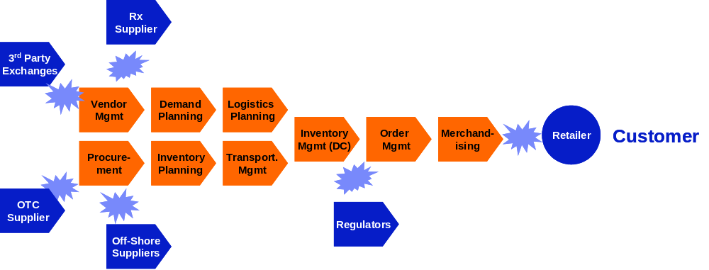
The traditional supply chain friction…
Competition b/w Companies
= Competitive Friction

Slide 15

And, how the supply chain has evolved…
Late 80’s
  Integrated Supply Chain within the ‘Four Walls’
Early 90’s
  Extended Supply Chain linked systems, limited information sharing
Mid 90’s
  ERP linking functions and transactions to the Supply Chain
Late 90’s
  Decision Support Tools, APS linked to ERP
Early 00’s
  Collaborative Supply Chains, Agility focused
Mid – Late 00’s
  Significant Outsourcing Models, Shared Data, eBOD

Slide 16
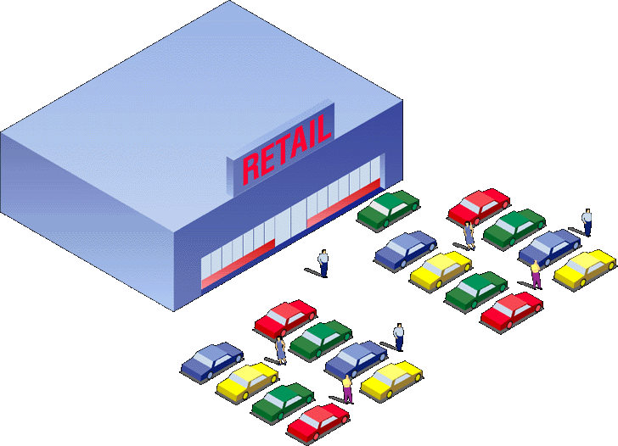


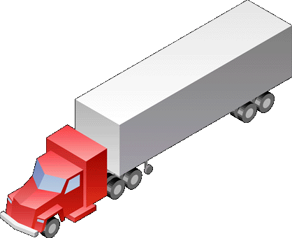

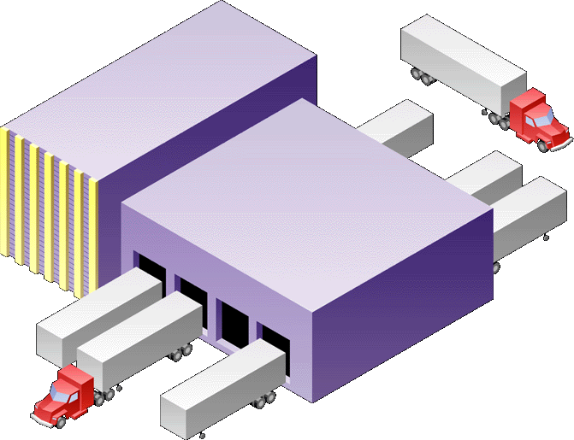



The supply chain in full flight…
From Traditional
Competition b/w Companies
To Agile
Competition b/w Business Models
Rx
Supplier
3rd Party
Exchanges
Vendor
Mgmt
Demand
Planning
Logistics
Planning
Inventory
Mgmt (DC)
Order
Mgmt
Merchand-
ising
Retailer
Customer
Procure-
ment
Inventory
Planning
Transport.
Mgmt
OTC
Supplier
Regulators
Off-Shore
Suppliers

Slide 17

Four trends are changing the value proposition
Responsive:
  Process is being seamlessly embedded between trading partners enabling rapid sense and respond capabilities across the value chain
Variable:
  Technology advances are allowing the entire value chain to become a virtual organization
Focused:
  Managing information effectively is becoming a core competency in effective supply chain management
Resilient:
  Effective supply chain management is strengthening its fiduciary role around managing risk and opportunity

Slide 18
Collaboration is critical to success
Focused
Merchandising
Distribution
Center
Resilient
Transportation
Responsive
MOVE
PLAN
BUY
Responsive
ABC Inc.
Supply Web
Inventory
Management
SELL
Variable
Variable
Rx
Dispensary
eBusiness
Exchanges
Focused
Resilient

Slide 19




Transportation (Variable, Responsive)
Nabisco’s logistics coordination system allows several manufacturers to share transportation costs associated with Lucky Stores deliveries
1
Nabisco uses electronic links to share trucks and warehouses with 25 other manufacturers including Dole and Lea & Perrins
2
Orders are electronically coordinated to meet retailers needs
Suppliers completely fill trucks instead of sending part-empty trailers
3
Albertson’s-owned Lucky Stores cut inventory costs in an 8,000 order test by closely matching orders and deliveries to their consumer’s needs
In addition, Lucky got lower prices on products
4
Notes:
Success Factors
Cooperation among manufacturers
Increased manufacturer-to-manufacturer and retailer-to-manufacturer communication
Deployment of interoperable communication systems for manufacturer, retailer distribution center and stores
Key Results and Metrics
Lower inventory, shipping and handling costs for both manufacturers and retailers
Lucky Stores cut inventory costs by $4.8 million
Manufacturers saved a total of $900,000 while Nabisco saved $78,000 in shipping costs
Fewer trucks needed, reduction of less than load (LTL) shipments
More efficient store operations
Sample Users/Vendors
Users
Albertson’s (Lucky Stores)
Nabisco, Dole
Lea & Perrins,
Capabilities”
Complementary load sharing with complementary/ competitive retailers
Online communication between manufacturer and retailer for coordination of logistics strategies
In-transit monitoring with online alerts when conditions fall outside of desired parameters

Slide 20


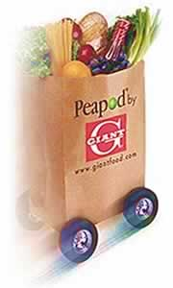






Distribution Centers (Variable, Resilient, Responsive)
Ahold USA’s warehouse network strategy includes a centralized facility (owned and operated by a third party) that supplies all of their 1,100 stores in the Eastern US
Philadelphia, PA
Products will be pre-sorted for each retail outlet at the centralized distribution center
1
Existing centers will be used for cross-docking of perishables
NY, NJ, CT, RI, MA
NY, PA, OH
2
Completed shipments will then be routed to area stores
DC, MD, DE, NJ, VA
NY, NJ,PA, WV
AL, GA, TN, NC, SC
3
Notes:
AHOLD is leading food provider in US (43B) with brands such as Giant, Tops, Bruno’s and Peapod. Very much east coast based! 45 independent store brands on four continents (70B euros HQ north of Amsterdam.
Ability to cross-dock shipments from central facility with perishable goods at regional centers
Availability of trucks to haul shipments longer distances
Deployment of warehouse management system (WMS) to manage products destined for 1,100 stores
Availability of labor to staff central warehouse facility
Improved efficiency for entire distribution system
Lower prices through centralized buying
Faster turnover in facilities
Regional warehouse specialization
Users
Ahold USA
C&S Wholesale Grocers (potential warehouse owner/partner)
Vendors
No sample vendors

Slide 21




Merchandising (Focused, Variable)
A CPFR pilot launched by Nabisco used the Internet to
coordinate category management opportunities with initially Wegman’s and subsequently a variety of chains
Determined the amount of product the retailer might sell in a quarter
Not consulted on quantity of product fed through the channel
1
old way
Exchange sales forecasts via the Web
Mutually agree on an amount of product to supply the retailer based on current sales data from the point of sale, past purchase patterns, and upcoming promotions
2
new e-way
Notes:
A CPFR pilot launched by Nabisco uses the Internet to
coordinate category management
Adoption of open-standards as well as common operating procedures and policies
Ability to integrate disparate systems
Acceptance of CPFR by leading companies and executives
Sharing of information between supply chain partners
Reduced inventories
Shorter cycle times
Better logistics management and planning
Improved forecast variability
Increased sales
Decreased costs
Users
Kmart, Target, Wal-Mart, Dansk, Sainsbury, Tesco, Procter & Gamble
Vendors
I2 Technologies
Manugistics
Syncra Systems Inc.
Logility

Slide 22









Merchandising (Resilient, Responsive)
UCCnet provides the foundation for internet based data exchange between retailers and suppliers by: providing a standardized product classification system; and defining data transfer protocols and technical architecture requirements for data sharing
Notes:
Collaborative commerce between retailers and suppliers on UCCnet’s trading platform will improve information flow
Participation by a critical mass of competitive packaged goods companies for retailers to have meaningful impact and to achieve anticipated efficiencies
Support of two-way data exchange by trading partners to ensure information synchronization
Integration between the various legacy systems throughout the supply chain must be achieved
Reduce discrepancies between supplier and retailer product information and flow-through
Improve invoice and shipment accuracy
Reduce incidence of invoice deductions due to incorrect shipments
Reduce paper based administration and data entry costs
Users
H.E. Butt1, Procter & Gamble1, SuperValu, Ralston Purina, PepsiCo
Vendors
No sample vendors

Slide 23





Inventory Management (Responsive, Variable, Focused)
The Sports Authority uses CPFR technology to share forecast and sales data with suppliers
1
The Sports Authority notifies its suppliers if products are moving as planned or sales are slower than forecasted
2
CPFR technology analyzes data and alerts category managers to exceptional situations that effect sales or delivery (e.g., the Asics 2050 is selling well – and that they will be out of stock shortly in 30 TSA locations)
Internet
3
TSA confirms issue to Asics via CPFR
4
Asics checks inventory and ships more shoes to TSA
5
Asics adjusts production quotas according to store results
Notes:
The Sports Authority uses CPFR technology to share forecast and results data with suppliers
Open standards for communication between suppliers and retailers
Accepted industry-wide operating procedures and processes to drive critical mass and facilitate adoption
Agreements between trading partners
Increased sales
Increased shipping and fill rates
Organizational streamlining and alignment
Administrative and operational efficiency
Improved cash flow
Ability to minimize in-store stock and warehouse inventory
Reduced inventory carrying costs and shrink
The Sports Authority, Kmart, Levi Strauss, Procter & Gamble, Wal-Mart, Syncra Systems

Slide 24


Inventory Management (Responsive, Variable, Resilient)
3
Upon arrival at the Goods Delivery Gate of the Future Store, the Shipment is passing an RFID portal. A door read message containing the collected items is generated and sent to the RFID Inventory Management System.The cartons are stored in the back room storage area.
1
Item Labeling
Scanning of the product barcode and writing of RFID tag that is applied to the item.
Storage area
Manufacturer Distribution Center
Future Store
FedEx
2
Case Building
Products are packed in a case that is equipped with a RFID-tag. The packing list is dynamically created while packing. Cases are sent to the Future Store using direct delivery.
Packing list is delivered to the Inventory Management system over internet.
5
The empty carton is removed from the RFID Inventrory Management system by carrying it through the Trash Gate
Labeled Item area
4
Store area
Each movement of a carton to/from the store area is reported to RFID Inventory Management system.
Notes:
The Sports Authority uses CPFR technology to share forecast and results data with suppliers
Open standards for communication between suppliers and retailers
Accepted industry-wide operating procedures and processes to drive critical mass and facilitate adoption
Agreements between trading partners
Increased sales
Increased shipping and fill rates
Organizational streamlining and alignment
Administrative and operational efficiency
Improved cash flow
Ability to minimize in-store stock and warehouse inventory
Reduced inventory carrying costs and shrink
The Sports Authority, Kmart, Levi Strauss, Procter & Gamble, Wal-Mart, Syncra Systems

Slide 25
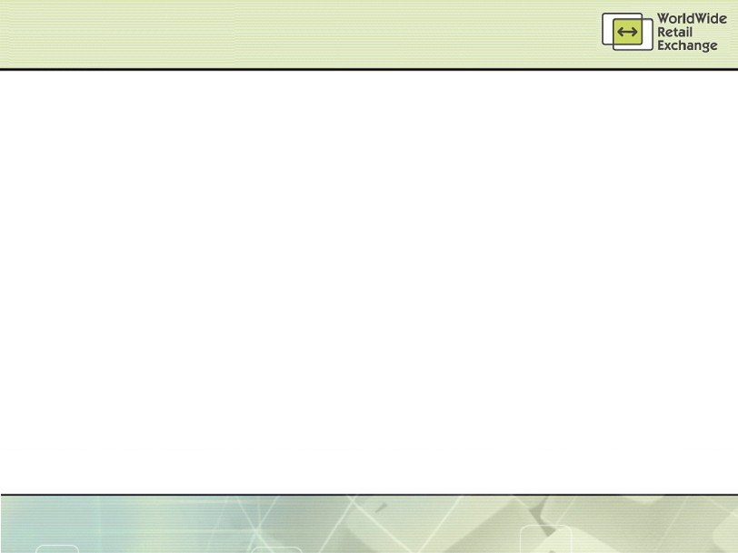
eBusiness Exchanges (WWRE)
Best Buy
Boots Company
CVS Corp
Gap Inc.
H. E. Butt Grocery
Hy-Vee Stores
JCPenney
John Lewis Partnership
Kmart
Longs Drug Stores
Marks & Spencer
RadioShack
Rite Aid Corp
Safeway (US)
Safeway plc (UK)
Sobeys
Supervalu Inc.
Target
Tesco
Toys R Us
Walgreen Co.
The premier integrated worldwide exchange community for retailers and their suppliers. Improving efficiency and lowering costs throughout the supply chain
eProcurement (Product Flow)
Auction
eRFX
Order
Execution
SCV
(Tracking)
Product Design and Development
PD&D
Replenishment
Catalog
Information/Reference Tool
Demand
Aggregation
C P F R®
Business Intelligence
(Information Flow)
Notes:
Hy-Vee grocery stores participates in an exchange run by ICS FoodOne
Commitment from enough manufacturers to make the exchange worthwhile for retailers
Utilization of the exchange by both category and store-managers
Deployment of technology in stores to access and trade in the exchange
Increased time for store managers to spend focusing on core in-store activities
Faster inventory turns
Decreased cycle times
Reduced inventory risk
Lower costs for both manufacturers and retailers
Users
Hy-Vee
Spartan Stores
Associated Grocers
Vendors
Internet Commerce Systems (ICS)

Slide 26
The Decapitalized On Demand Business
From Traditional... to Agile, Responsive, Variable, Focused, Resilient & Customer Driven
“Push”
Focus
BRAND CAPITAL
“Pull”
Focus
Production Focus
HUMAN CAPITAL
Customer
Focus
High
WORKING CAPITAL
Low
High
PHYSICAL
CAPITAL
Low
Outsourced Network

Slide 27

A few observations on what not to do?
Outsource everything (or anything you don’t like)
Let contracts control key processes
Ignore the physical capital
Forget to measure key business and customer metrics
Assume today’s model is tomorrow’s model

Slide 28
Rx Dispensary Leading Practices
Harley Rodin

Slide 29




Rx Dispensary: Central Pricing, Care Centre & Claims Switch
Success Factors
Culture shift with store & corporate commitment to central pricing allowing for localization
Platform to provide business services to stores
Leveraging the Rx network to achieve best tax rates, lower carrying costs, monitor the business, improve corporate communications, training, etc.
Fend-off PPOs
Provide for pharmacy program differentiation
1
Current State: Stores with individual price files & routes to adjudicated transactions
Key Results & Metrics
Store level administrative savings
Improved service levels
Consolidated and managed network costs
Consistency of brand image through drug file management
Potential to intervene in Rx filling to substitute alternatives & track cognitive services
Improved inventory and forecasting management
Achieve ROI
2
Best in Class: Centralized Pricing, Shared Services & Claims Adjudication Switch

Slide 30

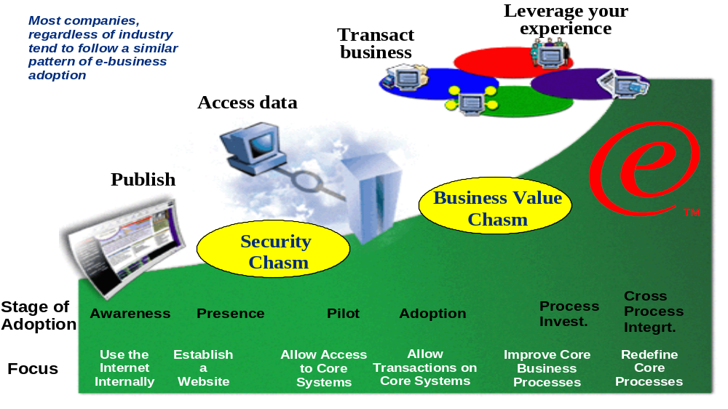
Navigating the -Health Mainstream

Slide 31
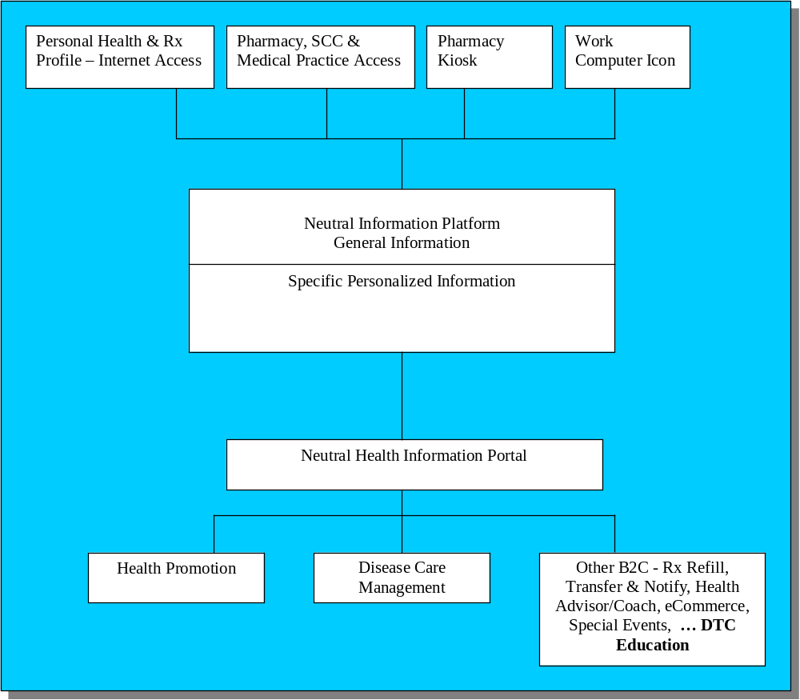
Portal capabilities are emerging in retail pharmacy as a new channel for DTC education and as a trusted resource for consumers

Slide 32
McKesson Executive Visioning Presentation
Doug Wilson, McKesson Canada

Slide 33
Agenda
  Introductions
  McKesson Overview
  Katz Group / McKesson Canada Relationship
  Observed Best Practices
  Katz Group Operational Assessment
  Summary of Key Opportunities
  Proposed Next Steps

Slide 34
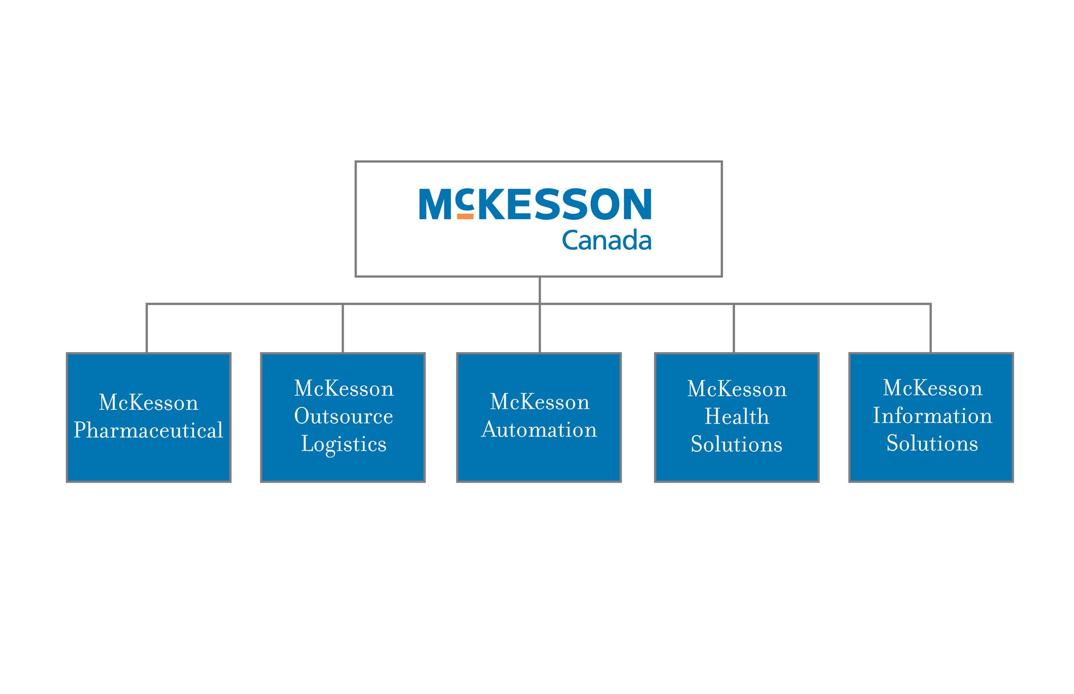
Introductions
Joe Varkul
VP / GM
Ontario Market Place
Graham Hardie
Director
Sales
Jeff Faria
Director
Operations
Doug Wilson
VP
Customer Solutions
Don Nicholson
KGC Account Manager
Promotions
Procurement
Logistics
Customer Service
Finance
IT / e-Commerce
Legal
HR
Automated Prescription Systems
Strategy & Business Development

Slide 35

McKesson Corporation Overview
McKesson Corporation is the leading provider of supply, information and health care management products and services in North America.
Ranked 20th of “Fortune 500”
30% N.A. market share (supply management)
22,000 employees
$50 Billion (USD) sales
Areas of expertise:
  Pharmacy distribution
  Medical-surgical distribution
  Management information solutions
  Inpatient/Outpatient pharmacy automation
  Health solutions

Slide 36

McKesson Canada Overview
McKesson Canada plays a key role in the Canadian economy and within the health care sector:
  Canadian head office (Montreal)
  Leading distributor in Canada
  1,900 employees
  Fifteen distribution centres
  Long term supply agreements
  Servicing over 7,000 community and hospital pharmacies
  Investment in the first automation robots for hospitals:
    Grand River Hospital, Kitchener
    Centre Hospitalier Affilié Universitaire de Québec

Slide 37
McKesson Canada Overview
McKesson
Pharmaceutical
McKesson
Outsource
Logistics
McKesson
Automation
McKesson
Information
Solutions
McKesson
Health
Solutions
Wholesale distribution of pharmaceutical and health-care products
Third-party logistics services to manufacturers including supply, marketing and distribution activities
Automated solutions to enhance pharmacy productivity and prescription dispensing accuracy
Comprehensive software solutions to improve information flow and decision-making
Products and services such as tele-health and nurse triage; focused on patent compliance and disease management
The result:
  Reduced costs
  Reduced medication errors and increased patient safety
  Enhanced quality of patient care

Slide 38
McKesson Canada Overview
Our Distribution Network
Edmonton
St.John’s
Vancouver
Winnipeg
Regina
Quebec
Calgary
Montreal
Moncton
St-Laurent
Brampton
Cornwall
Halifax
Full line
RxOTC
Frontshop
Outsource Logistics
Service Center
MOL
Ottawa
Mississauga

Slide 39
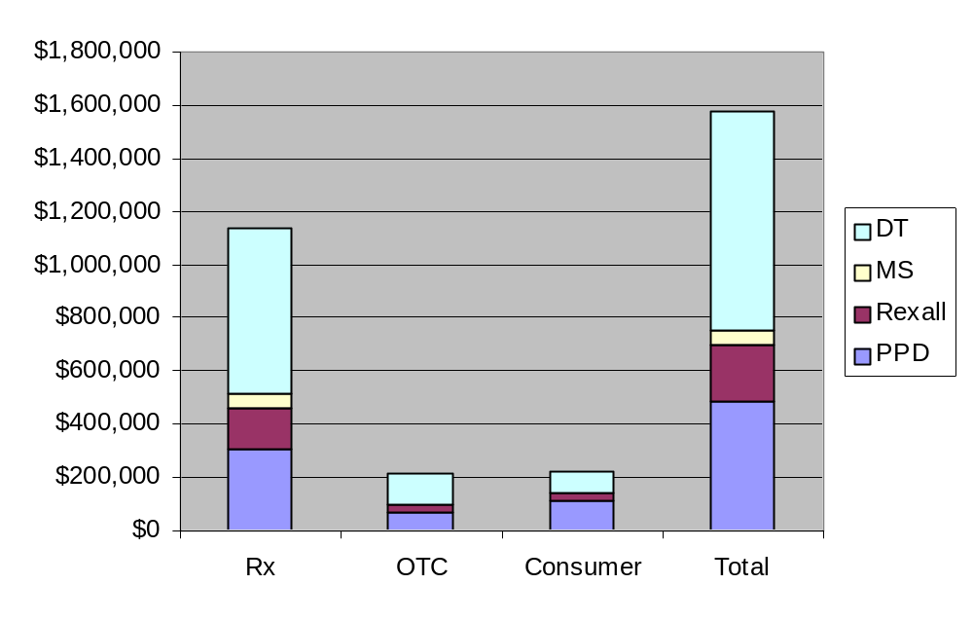
Katz Group / McKesson Canada Relationship
KGC Purchases by Class
April 1 – March 31 (01/02, 02/03)
Tightly integrated supply chain relationship
  Primary partner in Rx, OTC and Front Shop distribution
  High service levels
  Product listing flexibility
  Private label support
  Inventory system access
  Promotion process support
  Preferential routing design
  Manufacturer bill-back for promotional discounts
Source: McKesson Canada Purchase Data

Slide 40
Observed Best Practices
Automated Rx Inventory Replenishment
Automated Front Shop Inventory Replenishment
Electronic Order Management
Front-Shop Promotion Process Optimization
Dispensary Automation
Central Fill

Slide 41
Automated Rx Inventory Replenishment
Opportunity Description
Automated replenishment of dispensary inventory through the use of dispensary management software incorporating the required functionality
Reduction of manual intervention in day-to-day Rx inventory replenishment activities
Leverage of connectivity between KGC dispensary systems and McKesson Canada to electronically communicate replenishment orders, transmit invoices, and update inventory / pricing
KGC Current State
Of the KGC banners, Rexall is currently using auto-replenishment through the Kroll dispensary system
Other banners are currently using manual replenishment processes involving the Telxon ordering devices
Roll-out of the Nexxsys solution is underway throughout the KGC banners and will ultimately replace Kroll
The development of the auto-replenishment module for Nexxsys has commenced
Implementation Requirements
Business Impact
Standardization of dispensary management software (i.e., ProPharm Nexxsys)
Development and implementation of Nexxsys auto-replenishment functionality
Adoption of operating / system procedures to implement automated replenishment and leverage the McKesson electronic invoice file for store inventory and pricing update
Reduced Rx inventory, increased inventory turns
Reduced outdated product returns
Increased customer service levels
Redeployment of valuable dispensary resources to perform value-added services
Reduced reliance on casual staff for key ordering function

Slide 42
Automated Front Shop Inventory Replenishment
Opportunity Description
Automated replenishment of front shop inventory through the establishment of an electronic link between the store POS systems and McKesson Canada
Reduction of manual intervention in day-to-day front shop inventory replenishment activities
Leverage of connectivity between POS systems and McKesson Canada to electronically communicate replenishment orders, transmit invoices, and update inventory / pricing
KGC Current State
Front-shop inventory replenishment is primarily performed manually through the use of Telxon devices
Implementation Requirements
Business Impact
Auto replenishment functionality within store POS system
Adoption of operating / system procedures to implement automated replenishment
Change management / communication regarding store impact (e.g., benefits of auto replenishment), new procedures, roles and responsibilities
Improved in-stock inventory, increased revenues and improved customer service
Reduction in overall inventory levels
Reduction in over-stock returns
Redeployment of store managers to perform value-added functions related to category management, space management and customer service

Slide 43
Electronic Order Management
Opportunity Description
Internet-based order management to access product information, verify availability, place an order and receive confirmation, complete return transactions, manage back-orders, access special promotions, view purchasing history, and create valuable reports
McKesson Canada provides its customers with internet-based order management through its PharmaClik solution
KGC Current State
Drug Trading – 493 currently deployed, ongoing
Herbies – 11, fully deployed
Medicine Shoppe – 39 currently deployed, ongoing
Pharma Plus – 3 currently deployed (2 pilot, 1 DT)
  General roll-out June 6 in Ontario
  Expected completion by fall 2003
Rexall – 67 currently deployed, ongoing
Implementation Requirements
Business Impact
Drug Trading – enhanced performance possible through ProPharm VPN connectivity
Medicine Shoppe – VPN connectivity opportunity, issues related to minimum PC requirements
Pharma Plus – coordinating with ProPharm VPN scheduling
Rexall – concentrated deployment will continue following platform migration (i.e., Kroll to Nexxsys) and ProPharm VPN implementation
Improved ordering and order management efficiency
  Product information
  Real-time order confirmation
  Telxon / POS interface and order upload
  Back-order management
  Pre-booking orders and promotional list access
Purchase / invoice management & reporting
Reduced store inventory through POS integration
Increased customer service levels

Slide 44
Front Shop Promotion Process Optimization
Opportunity Description
Optimization of key promotional processes including:
  Item selection
  Pricing information
  Sales order form production
Transmission of promotional updates
Promotion order pre-booking compliance
KGC Current State
Current item selection process resulting in limited vendor order consolidation opportunities
Manual entry of pricing information into disparate systems increases likelihood and impact of errors
Current manual process for production of sales order forms for pre-books reduces promotional efficiency
Information required to update promotions is manually re-keyed into McKesson’s systems
Stores are not accurately pre-booking promotional orders resulting in lost sales and reduced service levels, or excessive inventories
Implementation Requirements
Business Impact
Focus on cross-banner promotional forecasting to increase vendor order consolidation opportunities
Integrate systems to reduce instances of pricing discrepancies, and establish electronic link
Automate production of pre-book sales order forms
Automate transmission of promotion update info
Establish processes to optimize pre-booking and create incentives to increase store compliance
Increased in-stock promotional inventory, increased sales, and increased customer service levels
Improved promotional process efficiency
  Reduced manual intervention through increased automation
  Reduced file maintenance requirements
  Reduced errors and associated verification, re-work / correction

Slide 45
Dispensary Automation
Opportunity Description
Automation of pharmacy functions through:
  Counting technologies
  Water dispensers
  Systems & work flow management solutions
  Robotics
KGC Current State
The implementation of counting technologies is currently underway within some banners
  177 Baker Universal scales
  7 Baker Cell Systems (2 at Medi-Trust)
  1 Autoscript III Robot
  117 Dial Rx IVR (in PPD stores) - an additional 19 systems are scheduled for immediate rollout
Implementation Requirements
Business Impact
Pharmacist acceptance
Modification of workflow processes
Minimal space and script count requirements
Reduced labour costs and re-deployment of skilled resources to value added functions (e.g., cognitive services)
Minimize impact of pharmacist and technician labour shortage
Reduced error rates
Increased fulfillment speed leading to improved customer service

Slide 46
Central Fill
Opportunity Description
Centralized prescription fulfillment where prescriptions are assembled, verified, packaged and delivered back to local pharmacy
Prescription data entry and delivery to the customer is done at the local store
Suitable for both refills (up to 50+% of in-store prescriptions) and new prescriptions
KGC Current State
Within the Katz Group, prescriptions are filled within the local pharmacy
MEDITrust currently employs automated prescription technologies to support its national mail-order pharmacy business. The centralized facilities and automation in use within MEDITrust could serve as the foundation for an expanded central fill capability
Implementation Requirements
Business Impact
Favourable legislation (currently only B.C.)
Decision re: central fill models:
  Customer Owned
  Transaction Fee Model
  Hybrid
Pharmacy connectivity to Central Fill Host
Central fill facility development (i.e., automation)
Reduced pharmacy workload
Reduced impact of pharmacist & technician shortage
Reduced customer wait time
Reduced labour cost / Rx and flattened cost growth
Reduced store inventory
Increased quality assurance
Increased store prescription capacity levels

Slide 47
Positioning of Opportunities
Business Impact
Opportunity
Proposed
Timeframe*
Ease of
Implementation
Increased
Revenue
Reduced
Inventory
Improved
Service
Increased
Efficiency
Automated Rx Inventory Replenishment
Q4
Automated Front Shop Inventory Replenishment
2004
Electronic Order Management
Q2-Q4
Front Shop Promotion Process Optimization
Q2-Q4
Dispensary Automation
Ongoing
Central Fill
2004+
* Proposed timeframe based on calendar year
Legend:
Low
High

Slide 48
Proposed Next Steps
Obtain KGC feedback re: opportunities, priorities and timelines
Adjust current initiatives to reflect priorities and timelines
Identify appropriate McKesson Canada involvement in Casper Project team
Participate in project plan development and execution for the Design and Implementation phases of the project

Slide 49
Supply Chain Vision
Rui Martins and Shai Verma

Slide 50
Contents
Current Supply Chain and Issues
Recommended Supply Chain and Implications
  Organization, Process, Technology, People
Capabilities that must be Developed
Alternative Paths to Achieving the Vision

Slide 51



Traditional Supply Chain
Wholesale Distributors
Customers
Suppliers
Manufacturers
Retailers
Information Flow
Product Flow

Slide 52

Current KGC Supply Chain
Other Retailers
Manufacturers
E3
TMS
Purchase Orders
KATZ Stores
Customers
WMS
POMS
Store Orders
POS Data
FMS
Suppliers
Invoices
Promotions
McKesson
Information Flow
Product Flow
KATZ HO

Slide 53
Current Organizational Challenges
Complete supply chain is subcontracted to McKesson – not only the physical warehouses, transportation and inventory but also the organizational skills to understand supply chain management.
Planning between KGC and McKesson as it relates to product flow is non-existent.
Performance metrics and targets used by McKesson are not aligned to those of KGC.
Communication across different functional groups within the organization is limited and collaboration with external trading parties is minimal.
  Multiple buyers per vendor contract results in a lack of overall category and contract understanding
Company wide standard operating procedures are limited, not applicable to all banners.
  Corporate wide / Banner wide purchasing and markdown policies do not exist
Currently, McKesson charges KGC approximately $70M annually for the services they provide (~4.9% of cost).
Additionally, McKesson also keeps the trade funds (~$10M annually) they receive from the manufacturers increasing their profit from the KGC account.

Slide 54
Current Process Deficiencies
There is almost no visibility into how McKesson is receiving replenishment orders and how they are fulfilling those orders to the stores. This creates a situation where there is no corporate understanding of what the inventory situation is at any store and therefore, prevents organized attempts to reduce inventory acquisition and carrying costs.
  Retailers live and die by an accurate understanding of their inventory position – KGC has no visibility to inventory at this time.
  During this project, industry-accepted inventory calculations were impossible to make due to the poor practices and data at the store level.
There is no single master file of all products carried in the KGC network. This prevents an organization-wide ability to understand what should be carried, what is carried and the price and profit on each SKU.
  In 2002, over 230,000 UPCs were scanned at the stores but only 50,000 codes are in FMS
Service level metrics are not calculated by KGC – we rely on McKesson’s calculations to assess how well they are meeting our requirements. Based on their calculations, they are fulfilling us at a 95%-98% service level but based on our own calculations, this is actually between 85% and 90%.
  We have subcontracted our supply chain to McKesson but we’ve also given them the responsibility to measure how well they are doing in meeting our requirements.

Slide 55
Current Process Deficiencies (cont.)
KGC is not receiving the benefit of its purchasing volumes and again, have given this benefit directly to McKesson through our contracts with them
  We’ve calculated that the trade funds promotion that McKesson is receiving from manufacturers is as much as $10 million annually.
Currently, KGC performs no demand planning activities and as such, inventory levels are higher than they should be and stock outs are probably greater than expected.
Promotion planning is sub-optimal has its done using manual processes with no integration to procurement and inventory management.
McKesson ships to regional warehouses and performs no trans-loading for KGC
  This means additional procurement costs and up charge rates to KGC

Slide 56
Current Technology Weaknesses
There are a general lack of supply chain management information systems at KGC. This includes no forecasting capabilities, no retail management platform and no inventory management tools.
There is no single, KGC-wide product file and associated pricing information which prevents system-wide pricing and promotions.
Perpetual inventory levels are not available across most stores. Inventories are taken once annually with occasional errors which limits KGC’s ability to be proactive about inventory management. There is no inventory visibility at corporate office.
There is inadequate systems support to perform accurate financial costing and sales analyses. Data is not available in a real-time environment thereby delaying management action on problems.
Point-of-Sale systems are not standardized across KGC. Most functionality is minimal and there is considerable frustration at the store level on their ability to help support store operations.

Slide 57
Current People Implications
Most KGC staff, both at head office and at corporate stores, feel they have poorly defined roles and responsibilities when it comes to supply chain management.
Head office staff do not have the tools to pro-actively monitor the KGC supply chain.
Replenishment of product is left to store personnel who do not have the tools to properly calculate replenishment quantities resulting in overstocks and out of stocks.
Stores have a resource scheduling challenge due to inconsistent product distribution.
There are unique processes by banner that promote silo-behaviour and reduce efficiency.
This silo behaviour results in a lack of accountability for results (i.e. stores purchase inventory for one-time individual discounts vs. corporate stores supporting centralized purchasing through category manager for enterprise-wide cost savings).
The lack of available real-time information for decision-making means that high priced management effort is being spent on non-value-added activities.
Store management time spent reconciling invoices limits their ability to proactively service customers, train, and communicate with staff.

Slide 58
Therefore ……
Based on the executive interviews, store visits, process workshops and quantitative data gathering and analysis, Project Casper has developed the following Supply Chain Vision:

Slide 59
Recommended Supply Chain Vision
A consumer-driven supply chain with collaboration and visibility across all trading partners controlled by Katz Group Canada
Guiding Principles
Build an organization to support supply chain excellence
Create a supply chain that is based on customer pull (demand) enabled by the store network
Provide visibility and control of inventory movement to Head Office
Manage and control the procurement of all products sold through KGC
Develop a single database of KGC product, sourcing and pricing
Provide real-time information when and where required
Leverage trust and collaboration between all trading partners
Understand and execute on the lowest cost to market
Build decision trees with clear responsibilities and accountabilities

Slide 60
Supply Chain Vision

Slide 61

Looking through the supply chain web
Information Flow
Product Flow
Manufacturers
Logistics
Providers
Large
K
Importers
Imports
Small
Ind.
3PL
Distribution
Centres
G
Brokers
C
Traditional
McKesson
Vendors

Slide 62
Katz Supply Chain Vision: Organizational Implications
The supply chain vision incorporates the development of a shared services model responsive to the needs of each of the individual banners. Shared Services will include Finance, HR, IT, Marketing and Merchandising.
The Merchandising group is broken into a Supply side and a Demand side.
The Demand side is responsible for managing the Brand, Channels, Products and Customers: category management, marketing, brand management, selling, content and customer relationship management.
Supply side concentrates on ensuring that stock is available to meet the Demand from customers. Supply side is broken into two distinct sides – Logistics and Supply Chain
Logistics is the physical movement of product. This includes Transportation and Distribution. This role of Logistics is to manage the physical flow of product through the Supply Chain network. The roles include Inbound Logistics, DC Operations, Outbound Logistics, Reverse Logistics, and Appointment Scheduling.
Logistics can be run internally or externally but must be visible and controlled by KGC.
The Supply Chain is involved in all aspects of maximizing the Logistics pipeline. Supply Chain is responsible for Planning, Forecasting, Procurement, Allocation, Replenishment, Inventory Management and Space Management.

Slide 63
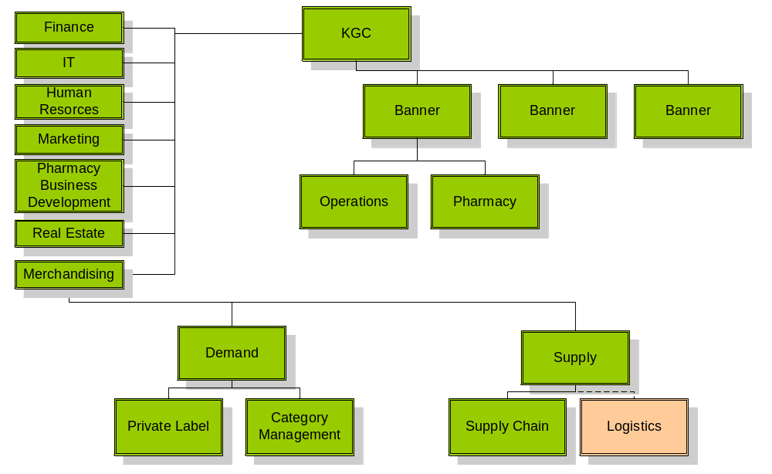
Potential Organizational Chart
Shared Services

Slide 64
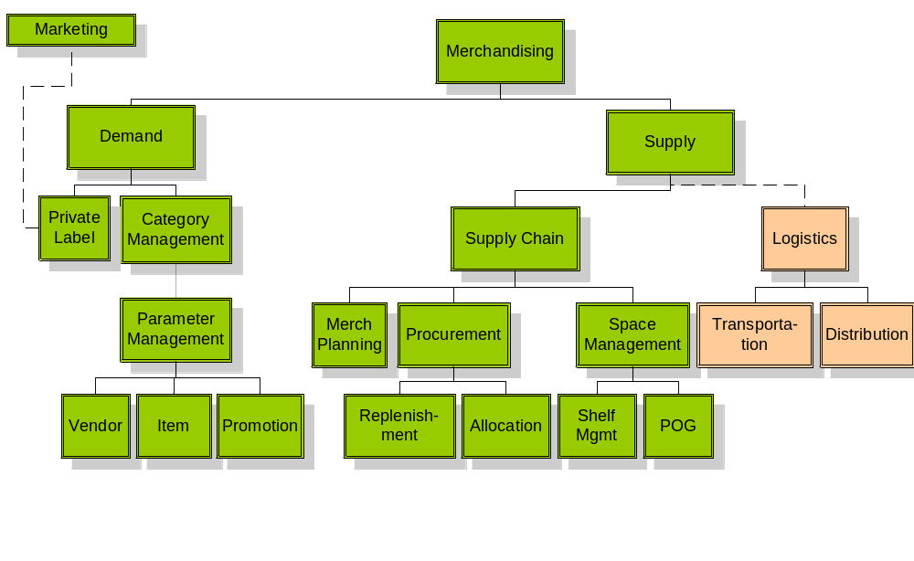
Potential Organizational Chart

Slide 65
Katz Supply Chain Vision: Process Improvements
Plan
Buy
Move
Sell
Merchandise Planning
Replenishment Flow Strategy
Buying Plans
Parameter Mgmt: Item, Promotion, and Vendor Mgmt
Planograms: Space & Floor Planning, Clustering, Shelf Assortment
Item Assortments
Purchase Order Management
Allocation of Orders
Forecasting and Replenishment
Inventory Management
Vendor Managed Inventory
Invoice Matching
Trade Funds Management
Outsourced or Self Provision
Receiving
Transportation Mgmt
Prepare Merchandise
Transfer and Returns
Warehouse Replenishment
Customer Fulfillment
Track Results to Targets
Item and Category Performance
Supplier Performance Metrics
Store-level Receiving, Inventory and Replenishment

Slide 66
Katz Supply Chain Vision: Technology Improvements
Plan
Buy
Move
Sell
Merchandise Planning System
Retail Management System
Collaborative Planning, Forecast & Replenishment
Space Management
Enterprise
Advanced Planning System
Purchase Order Management System
Allocation
Replenishment
EDI , XML ordering
Collaborative Planning, Forecast & Replenishment
Supplier Relationship Management (Vendor Scorecards)
Outsourced or Self Provision
Appointment Scheduling
Replenishment
Transportation Management System
Warehouse Management System
Collaborative Planning, Forecast & Replenishment
Advanced Planning Systems
Point of Sale
Scan-based Trading
Data Warehouse (Reporting)
Intranet/Extranet

Slide 67
Katz Supply Chain Vision: People Considerations
The shared services model will allow for the standardization of processes and performance measurements and will improve KGC’s ability to manage staff across banners.
The clearly defined roles and responsibilities will allow for the creation of standard skills templates, development programs and succession planning. This will prompt the need to establish a training management program.
Store management skills and job activities will be focused on analyzing data and decision-making vs. tactically reacting to conditions.

Slide 68
Supply Chain Capabilities Evolution
Optimize Distribution
Optimize Network
Match
Invoices
Manage Store Labour
Optimize Transport-ation
Manage Purchase Orders
Manage Vendor
Optimize Price
Manage Replenish-ment
Optimize Whse
Plan Store Specific Assort- ment
Manage
Receiving
Manage
Store
Inventory
CPFR
Manage
Promotion
Forecast Demand
Legend
Manage Perpetual Inventory
POS
Manage
Store
Prices
Manage Direct Store Delivery
Business Intelligence
Manage Store Orders
RMS
Manage
Trade
Funds
Manage Item
ERP
Report Financials
Manage GL/AP/AR
Allocate Merchan-dise
APS
EIS
2004
2005
2006

Slide 69
How is KGC Going to Achieve the Vision?
Legend
Low
High
Path | Benefits | Cons | Costs | Time | Risks
Buy | Obtain supply chain skills Can buy only parts that you choose to insource (i.e. front shop) | Integration challenges Potentially acquire more assets than are necessary for KGC business
Build | Potential to create strong internal buy in Custom designed for Katz needs | Internal supply chain skills do not exist
Rent | Focus on core competency Improved flexibility Leverage best practices from 3PL Conservation of capital Leverage economies of scale | Do not have full control Coordination issues Do not gain internal skills Costly in the long term
Mixed Mode | The final approach will consist of a combination of all of these options.

Slide 70
Change Management Implications
Nancy McTavish

Slide 71

Managing the Implications of Change at Katz
Objectives:
Enhance awareness of change implications and challenges of the Casper vision
Prioritize implications for action
“It must be concluded that there is nothing more difficult to carry out, nor more doubtful of success, nor more dangerous to handle, than to initiate a new order of things”
- Machiavelli
Notes:
Now that Rui and Shai have shared with you the vision, we thought it would be helpful to discuss what some of the change implications and challenges would be associated with the various options. Then in order to structure activities for implementation, we would like to gather your thoughts about which implications are of most concern to you.

Slide 72
The Change Readiness Assessment results identified some key issue areas for Katz
Clarity of Direction
Confusion About the Purpose of Change
Leadership not clear about the case for change
Limited sense of what is possible
Unclear direction, confused mandates
Targeted and Effective Communications
Measurements and Rewards
Not Supporting People to Change
Resistance to change and fear of unknown being perpetuated due to lack of a structured communication program
Messages are not currently planned to support people through the transition
A common vision has not been communicated
Lack of Commitment by Established Powers
Team competition and lack of focus on project vision
Inconsistent performance environment
"Silos"—divisional focus of action
Cultural Diversity
Culture Not Aligned with the Change
Values and behavioural norms are not consistent across Katz
Cultural disparity forces socialized behaviour (the way we do things around here)
Not experienced with cross-functional teamwork
Notes:
As part of this initial phase, we conducted a change readiness assessment which included interviewing 11 Katz resources. The purpose of the assessment was to understand and document the scope and magnitude of change and assess Katz’s willingness and ability to implement change.
As a result of analyzing the data collected, findings were clustered into four issue areas. Some of you have not had an opportunity to view these findings. So these issue areas are relevant to share with you now, as they are instigators for the change implications associated with the casper vision.

Slide 73
Change issues and implications are spawned from the transformation necessary to reach a desired state
Organization
Process
Current
State
Change
Management
Desired
State
(Casper Vision)
(Before Implementation)
Information
Technology
Process Redesign Enabled by Technology = Organization People Implications
Notes:
Each of the options associated with the vision involve technology and process changes. Therefore, it is critical to focus on the organization and people impacts because the effect of the implications can ground your business to a halt if not managed effectively. An example of this is a Volleyball game.

Slide 74
There are specific and generic change implications of the various scenarios
Generic
Organization Structure and Jobs
New roles and responsibilities
Job changes
Organization Administration
New policies and procedures across the organization
New performance metrics and measurement process
Competencies
Alignment of skills with vision and strategy
Establish training structure and standards
Buy
Build
Rent
Specific
Cultural alignment
Transition time
Transition effort and performance impacts on new and existing resources
HR infrastructure support (Recruitment, job profiles, skills development, performance management, training)
In-house resource capabilities and availability
Time to acquire or train-up skills and competencies
Capacity to build and move from business as usual quickly
HR infrastructure Support (Recruitment, job profiles, skills development, performance management, training)
Vendor Relationship Management
Project management capability and management of service level agreements
Procurement support
Strategy for knowledge transfer and resource acquisition
Control over performance measurements
Notes:
Let’s look at the various options in terms of specific and generic implications.
The generic implications would apply to any of the options, and it means that new roles and responsibilities will need to be defined and communicated, and changes will need to be made to existing jobs, regardless of the option. In addition, resources and structure will be required to develop and communicate new policies and procedures, and performance metrics and measurements will need to be developed to align with the new processes. In order to reduce the impact on performance, new competencies and skills will need to be identified and assessed against the current, in order to tailor the design and delivery of specific training modules and build a program that will embrace the new desired environment and build a professional development structure for on-going learning and development. Are there any other generic implications you feel should be part of this list?
Let’s talk now about the specific implications of each option.
Option 1 – Build in-house – Far to easy when building in-house to fall back into the old ways of doing things.
Option 2 – Borrow – short term or long term – Vendor relationship management is most important to ensure common goals are being achieved, and that existing Katz resources are not carrying the burden of an under-performing partner.
Option 3 – Buy – capability – You are familiar with the challenges associated with integrating different cultures. There will be a need to determine the desired cultural attributes that meet the new vision, and then determine whether to adopt a new culture, or change the culture of the acquired organization. This can also take time and resources to manage the transition.

Slide 75
Exercise
Prioritize implications into Low, Medium, or High
Low
What implications are not of much concern to you?
Medium
What implications concern you, but do not require immediate attention?
High
What implications are of great concern to you and require immediate attention?

Slide 76
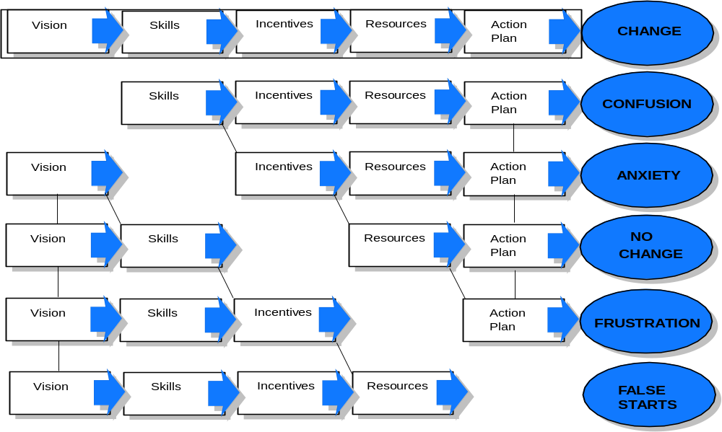
In Summary, Why Do We Need to Manage the Impacts of Change?
Notes:
We need to manage the impacts of change because, regardless of the option chosen, managing the impacts of change means there is a need to effectively address each element.
Establishing a vision, understanding the skill requirements and building them, determining the incentives that will be used to reward desired behaviours, having a resource management plan, and a well planned action plan will ensure successful change.
If any one of these elements are not addressed when implementing the vision, then change will not succeed.

Slide 77
Lunch

Slide 78
Breakout Session
Al Pinington

Slide 79
Breakout Session Agenda
Outline breakout session objectives 5 min
Select spokesperson to present findings 5 min
What do you like about the vision? 25 min
What do you dislike about the vision? 25 min
How can we improve the vision? 25 min
Conclude 5 min

Slide 80
Breakout Session Objectives
Evaluate the proposed supply chain vision
Lay the foundation for how to achieve this vision
Think through the design approach
Identify the key imperatives

Slide 81
Key areas to consider
Business
Processes
Technology
People
Organization

Slide 82
What do you like about the vision?
Organization | Process
People | IT

Slide 83
What do you dislike about the vision?
Organization | Process
People | IT

Slide 84
How can we improve the vision?
Organization | Process
People | IT

Slide 85
Breakout Groups
Group 1 Group 2 Group 3
Larry Latowsky Terry Buckley Mike Martin
Barry Elliott Eugene Gidaro Grant Schwartz
Bruce Moody Andrew Parkes Jonathan Alpert
Sue McCabe Al Wilkie Peter Davidson
Gersh Sone Chris Taylor Paul Dale
Paul Marcacio Brad Robbins
Norm Puhl
Facilitators
Lino Casalino Al Pinington Nancy McTavish
Room
Board Room Across the Hall Downstairs

Slide 86
Conclusions
Lino Casalino and Shai Verma

Slide 87
Recommended Supply Chain Vision
A consumer-driven supply chain with collaboration and visibility across all trading partners controlled by Katz Group Canada
Guiding Principles
Build an organization to support supply chain excellence
Create a supply chain that is based on customer pull (demand) enabled by the store network
Provide visibility and control of inventory movement to Head Office
Manage and control the procurement of all products sold through KGC
Develop a single database of KGC product, sourcing and pricing
Provide real-time information when and where required
Leverage trust and collaboration between all trading partners
Understand and execute on the lowest cost to market
Build decision trees with clear responsibilities and accountabilities

Slide 88
Supply Chain Vision

Slide 89
Looking through the supply chain web
Information Flow
Product Flow
Manufacturers
Logistics
Providers
Large
K
Importers
Imports
Small
Ind.
3PL
Distribution
Centres
G
Brokers
C
Traditional
Distributors
Vendors

Slide 90
How is KGC Going to Achieve the Vision?
Legend
Low
High
Path | Benefits | Cons | Costs | Time | Risks
Buy | Obtain supply chain skills Can buy only parts that you choose to insource (i.e. front shop) | Integration challenges Potentially acquire more assets than are necessary for KGC business
Build | Potential to create strong internal buy in Custom designed for Katz needs | Internal supply chain skills do not exist
Rent | Focus on core competency Improved flexibility Leverage best practices from 3PL Conservation of capital Leverage economies of scale | Do not have full control Coordination issues Do not gain internal skills Costly in the long term
Mixed Mode | The final approach will consist of a combination of all of these options.

Slide 91
Conclusions
The Supply Chain Vision presented today will require a wholesale change in the way KGC operates today.
KGC’s organizational structure will need to change to support the development of a supply chain mindset.
KGC employees’ skills and capabilities need to be significantly developed from where they are now.
The systems and technologies KGC currently uses will need to be enhanced and/or replaced allowing functionality to permit the collaboration and visibility that are the cornerstones of the vision.
Relationships with KGC’s vendors that have been built over the last many years will change radically.
Commitment to the direction needs to be demonstrated from the top and throughout the organization.

Slide 92
Recommended Next Steps
Ensure IT foundations are in place
  A. POS: One system and platform across all corporate stores
  B. RMS: Retail Management System
    Item, Vendor, Promotions
    Retail Financials – Invoice Matching, Trades Funds, etc.
    PO creations, Allocations, Replenishment
  C. ERP: Integrate into RMS for corporate stores
Pursue 3PL opportunity on selected categories
  Front shop product (excludes OTC & Rx)
  Need to renegotiate McKesson contract to lower OTC & Rx up charge costs
  Need to consider implications to Independents
Start building the organizational capabilities required to enabled the Vision
  Hire skilled supply chain professionals
  Identify and mentor existing employees

Slide 93
Thank Your for Your Participation

Slide 94
Appendix B
Change Readiness Assessment

Slide 95

Change Readiness Assessment Report
Change Readiness Assessment Overview
Findings
Recommended Initiatives
deeper
focus
Are You Ready?

Slide 96
The results and recommendations included in this change readiness report were generated by completing a series of steps from information gathering to analysis
The goal of the change readiness assessment is to understand and document the scope and magnitude of change required by key internal and external stakeholders and assess their likely willingness and ability to implement change.
Approach taken
Conduct Interviews
Document and
Synthesize Information
Assess against Critical Success Factors
Analyze Results
Recommend Initiatives to Mitigate Risks
April 25th
May 23rd

Slide 97
Using this approach to understand the impact of change is important because supply chain driven transformations are complex undertakings, that will stress Katz’s ability to manage and implement change.
Katz will experience some reduction in productivity; but the degree to which productivity drops, and the duration of time in which it remains low is directly correlated with its ability to manage the change effectively.
Initiatives have been identified at the end of this report to help Katz execute well coordinated change.
High
Well
Coordinated Change
“Change management is the hardest part of any of this... It dwarfs everything else”
Michael Hammer
co-author: Re-engineering the Corporation
Poorly
Coordinated Change
Performance
Uncoordinated Change
Low
Project Lifecycle (Time) ------>

Slide 98

Change Readiness Assessment Report
Change Readiness Assessment Overview
Findings
Recommended Initiatives
deeper
insight
Findings

Slide 99
During the change readiness assessment, several positive factors were found to exist that Katz can use to manage and support the supply chain project going forward
The need for change is understood
Perception is that doing nothing could impact the potential to manage growth in the future
Project leadership is perceived as very knowledgeable and committed
There is an eagerness to bring more value to the customer experience
History shows that there is a propensity and tolerance for change as a means to an end
The senior leadership team is perceived as being driven, proactive, and results oriented
A communications resource has been assigned to the project

Slide 100
Also during the assessment, stakeholders were mapped to help us begin to understand the role that each group would hold in the project
Stakeholder Group and Associated Roles
Set Change Direction
Deliver Change
Steering Committee
  Change Leader
B) Extended Project Team
  Change Agent
C) Other Executives and Directors
  Change Influencer and Agent
D) Corporate Stores
  Change Target
E) Independent Stores
  Change Target
F) IT
  Change Influencer, Agent, and Target
G) McKesson
  Change Customer
Customer
(Internal or
External)
Recipient of the change benefits whose views must be considered but does not authorise or participate in change
Facilitator/ implementer responsible for achieving change and has a contract with a change leader
Change
Agent
Lead Change
Change
Leader
Leader who demands and authorises change
Client staff who must change for benefits to be delivered
Influencer
Supporter and influencer who sometimes initiates change but cannot lead it
Change
Target
Stakeholders can and do change roles over the course of the change project
Stakeholders can play more than one role at a time during a change project

Slide 101
We found that given the groups in the identified roles, there is currently a gap between where each Stakeholder group is today and where they should be in terms of their willingness and capability to support the project going forward
High
Influence on Project Direction and Success
G
A
G
A
C
C
Medium
F
F
E
B
E
B
D
D
Low
1 2 3 4 5 6 7 8 9
Low: ‘Unconvinced’
Medium: ‘On-the fence’
High: ‘Champion’
Willingness and Capability to Support the Project
Back to routemap

Slide 102
Using the stakeholder map and interview results, findings were clustered into four issue areas that could pose the greatest potential risk to the success of the project going forward
1) Clarity of Direction
  The degree of alignment and understanding of the scope and impact of this project amongst senior leaders.
Degree of Risk to Project:
2) Targeted and Effective Communications
  The extent that two-way structured communication is used as a vehicle to increase the commitment level of each stakeholder group.
Degree of Risk to Project:
3) Measurements and Rewards
  The availability and acceptance of performance measurement and reward systems to reinforce and support the organization, roles, and skill changes required for the project.
Degree of Risk to Project:
4) Cultural Diversity
  The existence of common and well understood cultural attributes that align with, and support, the overall corporate and project vision.
Degree of Risk to Project:
L M H
L M H
L M H
L M H

Slide 103
Lack of a common vision and senior leadership alignment around the project scope will cause a risk that Katz will not adopt the rigor required to support the project
1) Clarity of Direction
Key Issues:
  Fragmented senior leadership alignment around project scope
    Steering Committee is perceived as being committed, yet have not had the opportunity to begin extensive communication of project vision to the rest of the organization
  Inconsistent understanding of whether project is a business or IT initiative
  No wide-spread understanding of the full potential of a supply chain solution or it’s role in supporting business strategies
  Uncertainty over role of McKesson in the project
Risks to the Project
    There is a risk that the organization will not adopt the rigor required to support an integrated business system if there is not active and ongoing alignment around the new mode of operations
      people are used to operating in ‘islands of excellence’ … trying to do a great job but in isolation
      people will default to their old tools and techniques if there is no clear evidence that the new operational model will be rigorously enforced
    Uncertainty over McKesson role will create confusion when design begins

Slide 104
A common vision that provides clarity and direction is necessary for the project and Katz as an organization to enable stakeholders to execute the strategy
Levels of Vision
STRATEGY
Core Vision
Principal Stakeholder Appeal
Senior Leadership
Extended Project Team
Everyone
How should this business compete?
Full Scope Vision
What is the full scope of change required?
Operational Vision
What does this mean for us/me?
REALITY
If you cry “forward”, you must make clear the direction you want to go. Don’t you see that if you fail to do that and simply call out the word to a monk and a revolutionary, they will go precisely in the opposite directions.
Antov Chekhov

Slide 105
Although communications is being enabled by the presence of a coordinator today, the structure and foundation for communication within Katz does not currently exist that will impede the stakeholders ability to become willing change participants
2) Targeted and Effective Communications
Key Issues:
  History of disconnects in communication from senior leaders
  Lack of enterprise-wide standards and expectations for delivery of communication
  Internal Communication vehicles exist but are under-utilized
  Uncertain expectations of roles and responsibilities of the project team members
  Common vision has not been well communicated
Risks to the Project:
    Lack of key stakeholder commitment to the “case for change” will not be well understood if a structure for communication does not exist.
    Expectations at the store level will not be set or met.
    Key stakeholders will not be prepared and may resist the change required.

Slide 106
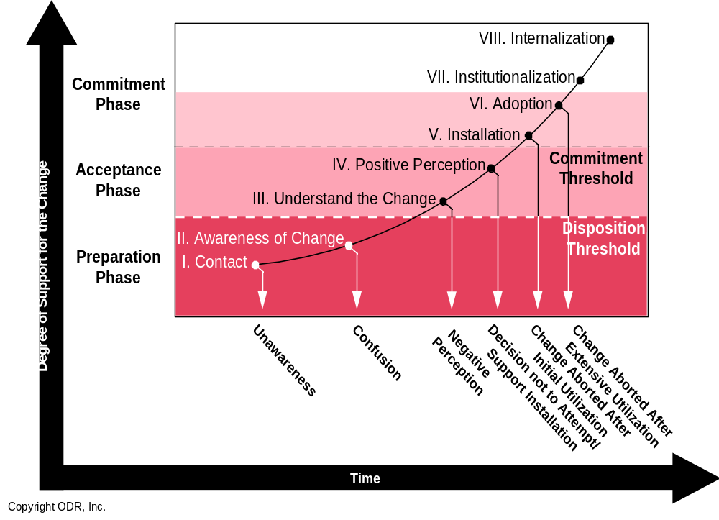
The establishment of a standard communication structure that addresses the needs of the various stakeholders is critical to gain commitment and buy-in and remove negative perceptions that will impede the progress of change
Katz is Here

Slide 107
Inconsistent performance metrics and measurements will impact negatively on the projects timeline and ability to maintain key resources
3) Measurements and Rewards
Key Issues:
  Lack of a structured performance measurement program
  Inconsistent performance environment
      Incentives and recognition programs
      Process structure
      Skills and tools
  Poor understanding of current skill levels as they relate to supply chain processes
  Limited exposure to incentives for project-based resources
Risks to the Project
    The project will lose momentum and focus as resources will be confused
    The progress of the project will slow down as resources, especially on the core team, will take more time to move up the learning curve on their own
    Without clear measurements there will be a tendency to push resources beyond their capabilities causing stress and burn-out of key resources
    Motivation will falter and there will be a high turnover of key resources on the project

Slide 108
Katz will need to move up the performance maturity level from Ad-hoc to ensure there is reinforcement for the new measurements, skills and learning required to support the project
Adaptive
Continuous improvement of the performance process is enabled by feedback and measurement of the process and from piloting innovative ideas and technologies. Success is the norm. Quality, outcome, cost and schedule performance is continuously improving.
Managed
Detailed measures of the effectiveness of performance interventions are collected and used by management. The process is understood and controlled. Success is more uniform. Quality, desired outcomes, cost and schedule conforms to plan.
Organized
Performance processes, systems and measurements are documented, standardized, and integrated into an end-to-end process. Success is more predictable. Quality, desired outcomes, and cost and schedule performance is improved.
Abbreviated
Some performance systems processes and measurements are established to track progress. Underlying disciplines, however, are not well understood or consistently followed. There is a lack of desired outcomes, cost overruns and schedule problems are the norm.
Ad-Hoc
Performance process is described as disorganized, and occasionally even chaotic. Systems, processes and measurements are not defined. Success depends on individual effort. Chronic quality, desired outcome, cost and schedule problems.

Slide 109
Lack of a cohesive desired culture at Katz will reduce the effectiveness of the improvements and efficiencies expected in the short and long term
4) Cultural Diversity
Key Issues:
  Cultural disparities lingering from transition
  Common voice and vision is not well articulated
  Cross-functional integrated team work is not the norm
  Common norms and values are not well understood
Risks to the Project
  Failure to break down the existing cultural barriers will
    add complexity to the implementation project
      If the silo mentality cannot be overcome in the development of the solution the implementation timeline Katz resource requirements may be put at risk
    put the ability to achieve the full value of an integrated solution at risk
    put the ability to leverage the supply chain solution as the foundation for growth at risk
    increase the long term cost of ownership and add complexity to future support and upgrades
  Risk that existing systems will not be ‘decommissioned’
    If units are not appropriately engaged to participate in enterprise-wide solutions there is a risk that functions in existing systems resist the migration to a common solution

Slide 110
Establishing cultural alignment with the strategy is necessary to maintain stakeholder participation in the project
Strong
Culture resists
strategy
Organisation not aligned
with strategy
Project will receive opposition
Culture reinforces
strategy
Organisation strongly aligned with strategy
Project will be embraced
Desired
Culture Alignment Strength
Culture not relevant to direction of strategy
Organisation drifts
away from strategic goals
Project will diffuse and lose focus
Culture not relevant to direction of strategy
Organisation is unfocused
Project will under-deliver
Current
Weak
Low
Fit with strategy/ change program
High

Slide 111
The readiness for change will be enhanced by leveraging Katz’s key enablers and reducing the impact of key issues found during the change readiness assessment
Key Enablers
Doing Nothing is Not an Option
Knowledgeable and Driven Project Leadership
Customer-driven Need for Change
Propensity and Tolerance for Change
Key Issues
Clarity of Direction
Targeted and Effective Communications
Measurements and Rewards
Cultural Diversity
Readiness for Change

Slide 112

Change Readiness Assessment Report
Change Readiness Assessment Approach
Findings
Recommended Initiatives
deeper
capabilities
Recommended Initiatives

Slide 113

To mitigate the change management risks, actions have been clustered into five areas of focus
Initiatives
Change Lead
Communication Strategy and Plan
Approach: Identify communication lead, key stakeholder communication needs, develop two-way communication plan, create messages, deliver key messages
Performance Management Support
Approach: Define new performance management requirements and skill gaps
Leadership Alignment
Approach: Identify strategic levers to cohesively cascade project vision and strategy throughout Katz.
Team Building
Approach: Identify team charter, desired norms and values, develop team effectiveness survey and distribute periodically
Mitigating Actions

Slide 114
The existence of a change lead is recommended to effectively manage overall design, development, and implementation of all change initiatives in a consistent and cohesive manner.
Change Lead
Purpose: The purpose of the change lead is to coach the change agents, represent and articulate the project vision and managing of all change initiatives across Katz.
Staffing Roles: The change team lead will be responsible for one or more initiatives; planning and managing the activities required to complete initiatives within specified timeframe; work closely with each area; identify and communicate change issues and risks; participate in bi-weekly status updates; delegate activities, where required to other team leads. The estimated number of resources includes one 50% Change Leader; one to two 20-25% team members.
Benefits: The change lead will ensure improvement in the overall comfort and readiness for change by cohesively delivering consistent project messages across Katz; facilitating leadership alignment activities, ensuring equity in the delivery of communication and organizational changes.

Slide 115
A comprehensive communication strategy and plan should be created with specific messages targeted to the commitment level of each stakeholder group according to key milestone dates
Communication Strategy and Plan
Purpose: The purpose of the communication strategy and plan is to define the strategies and mechanisms for effective two-way communication within and outside of the project to ensure that the right messages are delivered at the right time to the right stakeholders in the right manner.
Staffing Roles: There are two roles associated with this initiative. Initially, the communications lead will be responsible for designing the strategy and plan that will include the key messages, preferred delivery methods, timing, and feedback mechanism, by stakeholder group. The second role involves 20% of time to coordinating the development of the communication message, delivery of the message, receiving feedback about it’s effectiveness, and improving the overall plan, based upon feedback.
Benefits: The communication plan will identify the key messages required to enable buy-in. Having a clear communication strategy and plan will improve awareness and acceptance of the project vision and objectives to minimize the rumor-mill.

Slide 116
Targeted performance support is recommended to begin socializing the stakeholders and rewarding them for desired cross-functional teaming, and increase their level of comfort around the new supply chain process
Performance Management Support
Purpose: The purpose of the performance management support is to identify key performance measurements; define new roles and responsibilities; map the skills required to support the stakeholder groups who will be impacted by the implementation; and build a high level training strategy. This will serve as input to the end user training strategy and plan required for the implementation of Casper.
Staffing Roles: There is one core role includes a resource who is responsible for taking the desired skills and performance and working with each impacted organization to understand current roles and responsibilities and build a Training strategy and plan to address performance related gaps. The estimate for resources includes one 25% performance management lead.
Benefits: The performance management support initiative will enable the knowledge of new capabilities and associated performance measurements required for process and -centric thinking required to achieve the vision. Identification of skill requirements will provide greater depth to the training strategy and plan and enable an improvement in overall comfort and readiness for change.

Slide 117
Leadership alignment efforts will focus on creating an environment where everyone is ready, willing, and able to be creative, take initiative, and provide necessary support for the project
Leadership Alignment
Purpose: The purpose of focusing efforts on leadership alignment is to use a survey and workshop setting to help leaders address strategic levers to cohesively cascade the project vision and strategy throughout their respective units.
Staffing Roles: There is one core role that includes a lead resource who is responsible for executing the survey and facilitating the workshop. They will then be responsible for monitoring results and meeting with senior management periodically to coach ongoing progress. The estimate for resource includes one 5% of time throughout the duration of the project.
Benefits: Leadership development will enable senior leaders to focus actions to support the project implementation at a strategic and operational level enough to produce measurable results and add value to the project.

Slide 118
Team building, as an initiative, would include the identification and execution of activities to establish common norms and values to enable key stakeholders to work together more effectively
Team Building
The purpose of creating team building activities is to develop a cohesive team and charter that consists of desired team norms, values, and assessment tools to monitor team progress. This will serve to reinforce the overall cohesive culture of Katz.
Staffing Roles: The core team members will be involved in an initial workshop to identify desired norms, values and working relationships, and will create a plan for monitoring team progress. A team building lead will be responsible for executing the plan and providing feedback during status meetings. The estimated number of resources required will be key stakeholders for one half day. In addition, the team building lead will require approximately 5% of time throughout the duration of the project.
Benefits: This will improve the readiness for integrated execution by identifying realistic stakeholder expectations and providing guiding principles by which team members will interact and represent Casper.

Slide 119
Using a high level timeline, the plan suggests that some of the change management activities begin almost immediately, based upon their priority and ability to maximize benefit and overall effectiveness
C. Performance Management and Skills
D. Leadership Alignment
B. Communication Strategy and Plan
E. Team Building
A. Change Lead
Timeline
2nd Qtr 2003
3rd Qtr 2003
4th Qtr 2003
1st Qtr 2004
2nd Qtr 2004
3rd Qtr 2004

Slide 120
Appendix C Current Applications Assessment

Slide 121
Summary of Current Applications Assessment
JDE and PRMS (CA) meet basic needs for GL. A/P, and A/R
WMS/OM by McKesson. Need better Service, Inv visibility, daily/rush delv, order confirm/auto transfer to next supplier
ERP SW -- GL, A/P, A/R, HR, Order Mngt, WMS, Purchasing, Inv Control
Poor Stores Inventory Control and ordering by POS systems
Stores Systems being updated but Inv Control in next upgrade
In Store -- POS
Retail SW -- Merchandise & Promotion Planning, Trade Management, Price Optimization, Vendor & Rebate Management, Retail Intelligence, Shelf Space Planning
No functionality exists for most of these
No Forecasting and do not consider location in flyer
Unable to order more during promotion
Shelf Space planning not coordinated with shelf size and Store Replenishment, so goods occupy aisle and valuable floor space
No functionality exists for most of these
Over 75%Stores admin time spent in ordering/receiving/returns
Replenishment not in sink with demand and optimum order size
SC -- Demand Planning, Replenishment Planning, Supplier Collab/SS
Systems needed for marketing to Independent Stores, end Customers and optimizing Store Locations
Other -- Marketing System

Slide 122
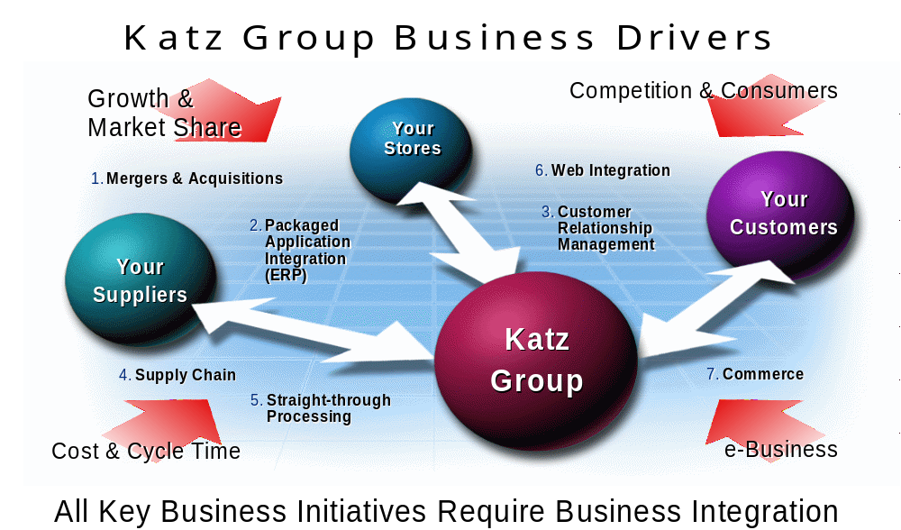
We did a high level review of how current application systems support your business processes

Slide 123
Areas covered during this Application assessment
This workshops
focus
Development
Presentation (Web UI, Portals, e-business,
Supplier Sites)
Common Services
(Security, Directory Services, Application Management)
Business Applications
(Packaged, Best of Breed, Legacy)
Business Integration
(EAI, Messaging, Queuing, Integration, Workflow)
Infrastructure/Technical Architecture
(Platforms & Networks, Wireless,
Operating Systems, Databases)

Slide 124
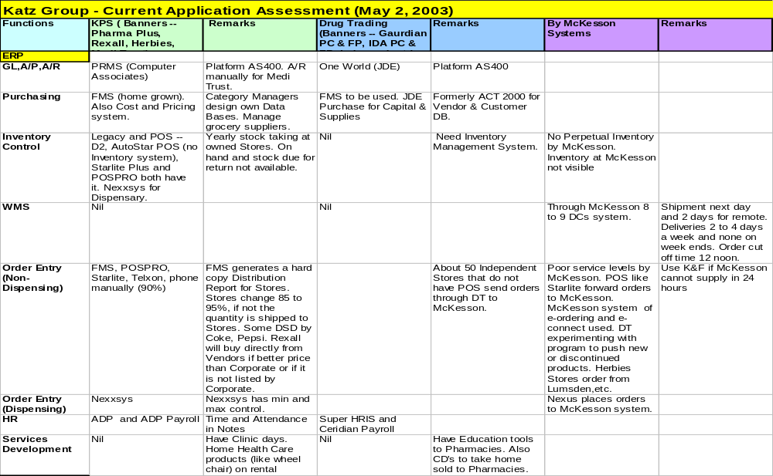
Current Applications Assessment

Slide 125
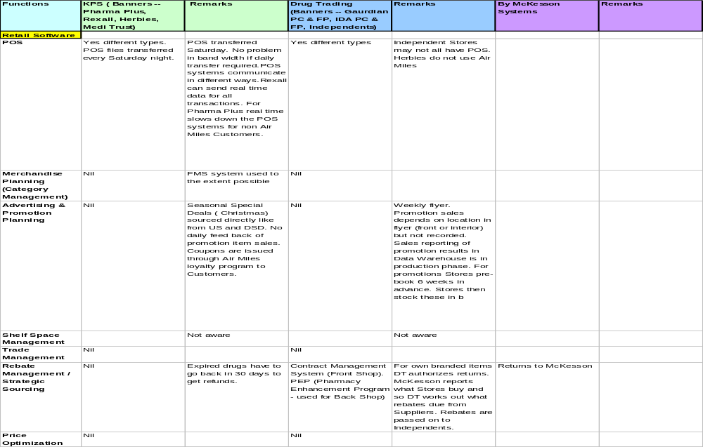
Current Application Assessment (continued)

Slide 126
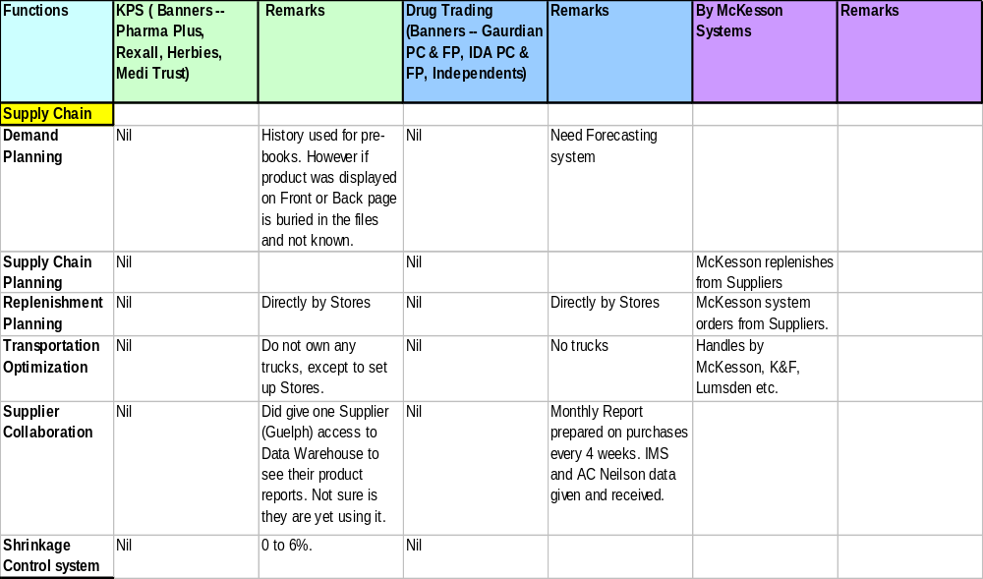
Current Application Assessment (continued)

Slide 127
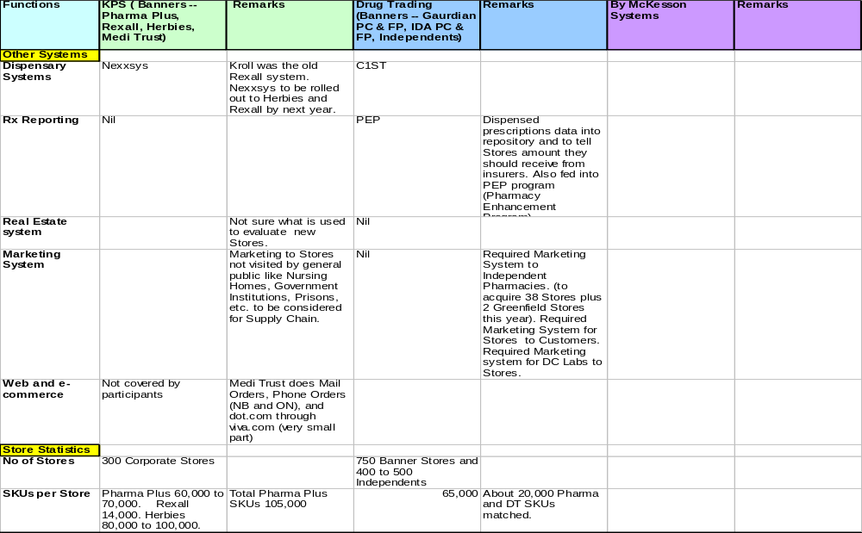
Current Application Assessment (continued)

Slide 128
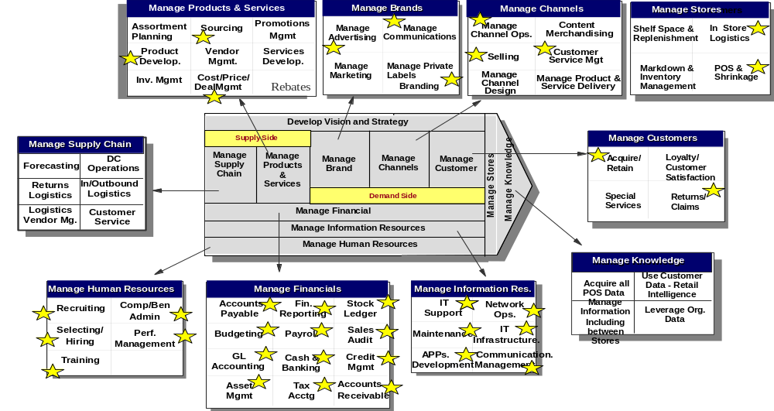
Current Katz Applications
Existing
Katz
Systems
Existing
McKesson
Systems

Slide 129
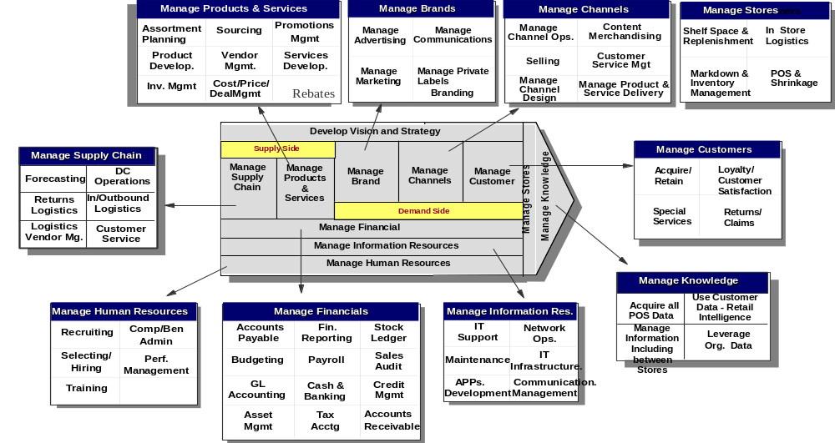
Opportunity for additional Applications at Katz
Proposed
Katz
Systems
Existing
McKesson
Systems

Slide 130

Current and proposed Applications at Katz
Katz Systems
Current
Proposed
Existing
McKesson
Systems

Slide 131
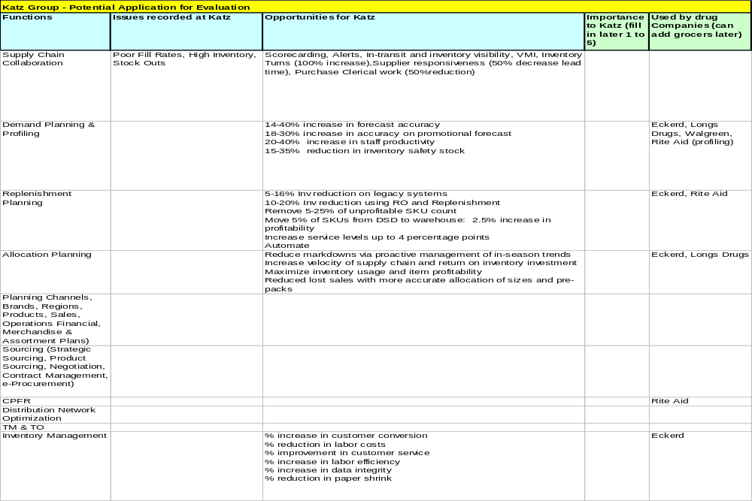
Potential Applications for Evaluation

Slide 132
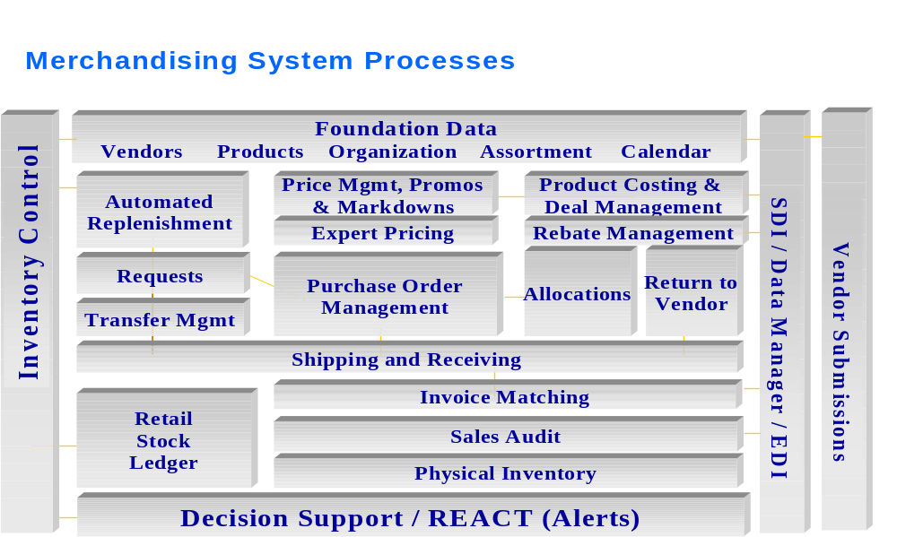
Check list for additonal retail application modules

Slide 133
Appendix D
Supply Chain Assessment Summary

Slide 134
Item master is inaccurate and not complete
Process
The item master, maintained in FMS, does not contain all of the SKUs sold across the corporate banners and many of the SKUs have inaccurate detail information.
Issues
Not all SKUs in the item master
Item master is not in sync with McKesson, not leveraging the McKesson-Katz custom catalogue for item master maintenance
Wrong UPCs in item master from vendors, lack method to validate UPC
Incorrect product parameters in item master (descriptions, pack size, etc.)
Labour intensive process to add/change a SKU in the item master
Products can reach stores prior to being available in the item master due to long lead time to add item
Impact
Items not in item master do not scan at POS unless entered manually by store, results in additional manual effort for item input
Non-scanning items result in lower customer service while customers wait
Delayed new product launches due to long lead time setting up a product

Slide 135
Standardized pricing policies across the organization are lacking
Process
Ad hoc pricing is performed across the organization. Policies are not followed consistently across the organization and pricing errors are common.
Issues
Pricing from head office not accepted by all stores
Pricing optimization is not being performed
Multiple items per promo have incorrect prices
Price groups are not being used, manually intensive to make a price change
Pricing zones do not adequately group stores to reflect geographic, demographic and banner differences
Different retail prices in a line of product (i.e. different flavours)
Rexall private label pricing is uncompetitive for some products, higher than national brands
Impact
Product, category and overall profitability not optimized
Incorrect prices result in poor customer service
Significant manual effort to maintain prices

Slide 136
Merchandise life cycle is not planned appropriately
Process
Assortment planning decisions do not fit the needs of all banners. Discontinued items are managed unsystematically.
Issues
Product assortment does not reflect buying patterns in many stores, store specific assortment planning does not exist
Planogram shelf sizes do not coincide with store shelf sizes
Planogram execution at the store level is ad hoc and no compliance measures exist
GMROI by product category is not readily available to aid in planning
Delisted items are removed from planograms but no plan is provided to clear them out
Progressive markdowns are not being used for delisted items
Lack of flex space in planograms
Impact
Product and category profit are not optimized
Significant changes are made to assortment and layout at store level because planograms vary significantly from store needs
Excessive delisted items increases inventory levels
Planogram investment is providing a low return since many stores do not follow it

Slide 137
Lack of promotion and event management automation
Process
Promotion and event management is performed manually making it time consuming and prone to error.
Issues
Multiple promotion packages sent to store, pictures are not available in the ad package
Promotion management is manually intensive and the cycle time is long
Promotion effectiveness is not evaluated when completed
Promotion pricing and bonus Airmiles are not accurate for numerous products when flyer breaks
Limited external factors considered when preparing a promotion
A promotion on regular products does not automatically promotion bonus items
Some promotion timeframes overlap and are not managed effectively
Changes to promo not frozen until flyer goes to print
McKesson has inventory problems post promotion due to poor planning
Impact
Significant manual effort required to prepare for and execute a promotion
Incorrect prices and incorrect bonus Airmiles reduce customer service
Promotion profitability is not optimized

Slide 138
Demand planning and forecasting activities within Katz are immature and do not support the Katz business
Process
Limited demand planning and little forecasting makes it difficult to manage what products and quantities should be supplied in each store
Issues
Some promotional items are forecast based on historical sales, front and back page items
External factors such as seasonality, major events, etc. not considered in forecast
Forecast accuracy is not measured
Lack visibility of prior promo criteria when making forecast at store level
Regular items, excluding private label, are not forecast
Demand planning is not performed since visibility of inventory is not available
Forced distribution does not reflect actual store requirements
Linkage between bonus UPC with regular UPC and discontinued UPC with substitute UPC does not exist
Impact
Excess inventory since replenishment not linked to forecast and forced distribution not appropriately adjusted for a particular store
Reduced customer service levels due to out of stocks

Slide 139
Corporate Measurements are lacking
Process
Only a small amount of information is available to track Katz performance. The information that is available and visible has limited usefullness.
Issues
Information visibility across the organization is very limited
Corporate measurements are limited and focus on high level performance
Performing root cause analysis on discrepancies is difficult due to unavailable detailed information
Balanced scorecard does not exist to measure corporate performance
Customer service levels (out of stocks) are not measured
Impact
Decision making is impaired due to limited information
Actioning problems is difficult without detailed before and after data

Slide 140
Perpetual inventory is not being used for the majority of stores
Process
Perpetual inventory is not available for most of the stores. Unable to view what is on-hand to make appropriate ordering, demand planning and assortment management decisions.
Issues
POS system is not standardized across the organization
Perpetual inventory not turned on for most stores
Perpetual inventory information not available at head office
Annual physical inventory is “blended” for Pharmaplus and Herbies
Little use of cycle counts to manage inventory
Inability to perform forward buying corporate wide
Lack of control over inventory in the supply chain
Inventory parameters (safety stock, min, max) are set without optimization
Impact
Excess inventory and high safety stocks because there is no visibility of what is available
Difficult to accurately account for shrink thereby reducing loss prevention effectiveness
Stock outs are not visible because inventory visibility does not exist, cannot estimate true customer demand

Slide 141
Katz is unable to leverage its purchasing power
Process
Katz has not leveraged its purchasing power across all banners to achieve the best price. McKesson benefits from the Katz volume purchased.
Issues
Negotiations with vendors do not leverage the true purchasing power of Katz
PO’s sit with McKesson thus they benefit from Katz volume purchased
Katz cost is sometimes higher than Wal-Mart retail
Deals obtained from sales reps at store level not communicated to head office to leverage across the organization
Some stores executing contrary to banner strategy (maverick buying), no policy or system in place to counter it
Rexall stores exercise a lot of control over sourcing outside the corporate contracts
Impact
Higher cost for purchased products which reduce competitiveness and profitability
Loosing volume rebates due to maverick buying

Slide 142
Intercompany communication and intracompany collaboration is limited
Organization
Communication across different functional groups within the organization is limited. Collaboration with external parties is also minimal
Issues
Multiple buyers per vendor contract results in lack of an overall category and contract understanding
No ability to share industry knowledge across Category Managers
Collaboration with vendors beyond McKesson is limited to promotions
Other then McKesson, vendor performance is not measured
Stores do not understand planogram criteria/objectives
Katz is not always aware of new products/substitute products
McKesson requires forecasted demand by SKU for core items to improve service
Do not collaborate with McKesson on improving vendor performance
Limited amount of product transfers across stores
Impact
Sub-optimal decision making across the organization due to limited information availability
Difficult to improve trading partner performance when working independently from them

Slide 143
Standardized policies are not available
Organization
Company wide standard operating procedures (SOPs) have not been created.
Issues
Corporate strategy and vision not institutionalized or communicated
Lack planogram company/banner standards
Corporate purchasing policy does not exist
No corporate markdown strategy
Impact
Not leveraging most efficient processes company wide
Customer experience can vary significantly in similar stores

Slide 144
Employee training is minimal
Organization
Employee training at head office and stores is primarily on the job training. Very little formalized training exists.
Issues
Category management training is very limited
Training on policies and procedures is not occurring
Very limited training and documentation is available for current systems in use
Impact
Reduced productivity since employees may not be performing their functions as efficiently as possible
Variable customer service delivery, not standardized across banner

Slide 145
Head Office reflects PharmaPlus needs
Organization
Many head office activities are implemented to meet PharmaPlus needs in Ontario with minimal regard for the Herbie’s and Rexall banners.
Issues
Planograms tailored to PharmaPlus needs, not Herbie’s or Rexall
Delistings based on PharmaPlus sales
Item master is incomplete for Herbie’s, based on Pharmaplus requirements
Price book geared towards PharmaPlus
Impact
Herbie’s and Rexall are unable to leverage head office activities

Slide 146
Inability to perform accurate financial costing and margin analysis
Technology
Accurate financial costing is not being performed with gross margin estimates being developed for each store.
Issues
Gross margin for each store is estimated
Actual amount of shrink is estimated
Inventory write-offs are unknown
Financial management system can only hold 1 cost per product
Product margin is based on the current cost in the system not a weighted average cost
Rebate sharing is based on a stores historical sales not actual sales
Net-net price is not visible at store level
Inability to drill down geographically
No SKU by SKU competitive analysis
Impact
Decision making is hampered since analysis is dependant on inaccurate costing
Unable to measure the effectiveness of loss prevention program because actual shrink may not be accurate
GMROI by product and category can not be accurately calculated
Stores can lose money on promos due to rebate sharing mechanism

Slide 147
Limited reporting and analysis tools
Technology
Tools are not available to perform analysis on sales, profitability and inventory data.
Issues
Cannot do regional profitability analysis
Competitive analysis is difficult / effort intensive
Price and sell thru impact difficult to track
Microstrategy weekly update of sales information is not timely, lack realtime sales tracking to see impact of price changes
Lack ability to perform to do price and profit optimization for items and categories, no price modeling / elasticity software
Lack sales/linear foot analysis in underperforming stores
Unable to perform what-if supply chain analysis (i.e. optimal inventory levels, forward buying, optimized scheduling)
Harmonize sales reporting across banners
Impact
Company wide performance is sub-optimized

Slide 148
System integration is minimal
Technology
Many of the legacy systems are not integrated or loosely integrated. Sharing of data is a resource intensive process.
Issues
FMS not integrated with category management database
Perpetual inventory data from stores not visible at head office
No link between FMS & Nexxsys
Separate database for contract information, not readily available to individuals who need access
Can’t confirm receipt of weekly POS download from FMS
Resolve multiple download issue
Auto replenishment tool
Move all stores to Microstrategy (No negative feedback on this technology)
One stroke receiving process
Impact
Data maintained in multiple locations drives additional effort and potential errors

Slide 149
Appendix E
Consolidated Interview Data

Slide 150

Executive Interview Summary
Executive interviews completed April 14th to April 24th
Interviewee | Title | Complete
Larry Latowsky | President & CEO
Al Wilkie | VP Operations Rexall
Craig Taylor | VP Merchandising
Jonathan Alpert | VP Merchandising
Terry Buckley | President Herbie’s & CMO
Gersh Sone | VP Pharmacy
Peter Davidson | VP Human Resources
Sue McCabe | VP Private Label
George Edwards
Grant Schwartz | Chief Information Officer
Mike Martin | Chief Financial Officer
Bruce Moody | VP Operations PPDM

Slide 151
Consolidated Interview Data
Question | Summary
What are the key market and competitive drivers? | Being in-stock Merchandising (Tailor line drawings to stores - geographic, demographic, ethnic differences) Flow of goods for promotions (ensure in stock). Company is using many fragmented systems, only have POS sales information for corporate stores. Only 40% of the pharmacies are using the replenishment functionality. HR manages 6,500 employees with 9 people in HR/payroll.
Where do you see the company in 5 years time? | Multi Banner Larger PharmaPlus & Rexall stores, currently 6-7k sq. ft. increasing to10-12k in future. Convenience, OTC, Cosmetics, destination shops World class retailer with word class systems. Have a more national approach rather than regional. Convert independents into corporate stores. To be the #1 Health Provider in Canada (prescriptions filled). More control of destiny (buying, processing). Convert pharmacists into business managers. #1 Pharmacy service provider in North America Do patient counselling, nutrition, aromatherapy, cosmetics and other health and fitness goods and services

Slide 152
Consolidated Interview Data
Question | Summary
What are the current business goals and objectives? | Increasing private label sales currently only 2%-3% of sales. Managing inventory, increasing sales, improving margins and reducing labour costs Perform price optimization. Improve new product introductions. Adjust item assortments by demographics and regions.
What are the CSF for meeting/achieving these? | Katz could increase turns if McKesson has high availability
What are the Executive key performance indicators? | GMROI by category (not available) Inventory Turns (5 turns overall, 3 turns front shop) Limited reporting is available and difficult to extract valuable information. Profitability and EBITDA General Ledger margin is used but calculated in a questionable way. Out of stocks are not being measured systematically (i.e. store audits)

Slide 153
Consolidated Interview Data
Question | Summary
What do your major customers and suppliers need? | McKesson requires improved communication (both ways). Any savings generated at McKesson will not be shared with Katz. McKesson is not good at front shop wholesaling. Vendors do not have access to historical sales data from POS. Currently a very manual process to maintain prices. McKesson perception is that there is no money in the front shop, pick and pack, little bulk
What key initiatives are currently underway? | Increase private label sales, currently 2% of total Rexall, 4% of Rexall front shop. Will begin price optimization and begin taking into consideration demographics in planograms. Implementing satellites and TVs at stores, allowing for training. Reduce POS systems (never get to one) Rexall will implement full Nexxsys functionality. Developing a new pricing catalogue that will take into consideration competitive pricing and regional differences. Rebuilding and repositioning the Rexall brand (use Dave Nicholls as a consultant).

Slide 154
Consolidated Interview Data
Question | Summary
What are the main process issues? | Out of stock Manual replenishment process, used to be automated. Receipt of goods not linked to Pos, don't scan receipts at the store, only spot check some shipments. Lack of control over the flow of goods. Credits are not shared fairly. Pay McKesson based on invoices, not on negotiated deal. Tracking inventory is difficult, no perpetual inventory system. No customer service measures. Item master missing Items for Herbies who carry more fineline, colours, flavours Planograms are not differentiated by geography (same shelf set across country) Pharmacists overbuy to create own safety stock. Multiple inventory, OTC from front shop to back shop Price optimization is not available in the system. Do not know costs and what true gross margin is. Price book geared towards Pharmaplus Price groups are not being used. Item maintenance at store level is number 1 issue. Very little training corporate wide McKesson is unable to link the UPC code of an old item with new items (i.e. linking new Rexall products with old Certified products). Need controls/management system to monitor cost and price

Slide 155
Consolidated Interview Data
Question | Summary
What is the resulting business impact? | Lower service levels, higher inventories due to out of stock. Buyers spend 75% of their time collecting and massaging data to perform their job. Level of accuracy and granularity is low.
What are the desired process outcomes? | Line drawings tailored to stores. Improved reporting (GMROI). Utilize price optimization. Price zones/lanes by banner, multiple priocing by banner & location Perpetual inventory Harmonized cost system
What is known about competitor capabilities? | Competitors have 15% private label penetration compared to 2%-3% for Rexall. Shoppers has 40% more front shop
What improvement projects are underway? | Goal is to have perpetual inventory in 2003. Will likely implement ADP payroll system in Rexall this year.
What would be the most beneficial improvement project? | Store generates planograms based on their environment and corporate constraints / criteria. Visibility of pharmacy inventory Inventory reduction

Slide 156
Appendix F
Consolidated Store Visit Data

Slide 157
Store Visit Summary
Manage Categories:
Would like more store owned items, to cater to local needs. Less forced products.
More thorough thoughts of CMs.
Price comparison guide with local competitors.
Assess customer flow in-store by section.
List item:
McKesson should be pro-active with UPC changes. There is no linkage.
Some items listed not scannable, and vice versa. Some are not activated/listed.
Wrong scan at markdown.
Manual add for seasonal and promo items.
Conflict with flyer items.
Pharmaplus fineline not applicable to Herbie’s grocery.
Regular/Bonus item listing.
Discontinued items.
Retail lower than sale price.
Planogram:
Flexibility in general to allow store owned items/extra footage.
Planogram sizing not always correct.
Better arrangement of faster moving items/CM issue.
Not updated very often.
Not pushing enough Rexall product.

Slide 158
Store Visit Summary
Forecast demand:
Too time consuming/integration of sales history into sales bulletin.
No forecast for regular, but minimal done for promo and seasonal. Based largely on FP/BP.
Forced distribution/quantity issues.
Specialty CM for opportunity buys.
Markdown price:
Corportate for discontinued, otherwise ad hoc process.
Reports on slow moving items.
Store transfers.
Try not to go below cost.
No strategy, but would like to see advice from HO.
Manage inventory:
Check backstock then order. Very ad hoc process.
Problems managing discontinued items, idle product.
See on-hand/label making on Telxon units.
Auto-replenishment program.
Small stores don’t see point in computerized inventory system. (Cost and usefulness issue)
Velocity codes.

Slide 159
Store Visit Summary
Safety stock:
Ad hoc mins and maxes.
Done by section by person.
List of top 100 items suggested.
Small stores use count cards.
Usually 1-2 week safety in general.
Pre-book:
Ability to net inventory with pre-book.
More flyer stability, less last minute changes by CM.
Info sheets combined.
Pre-book too far ahead causes trouble with future inventory forecasts.
Would like to see what is going to be fulfilled in the order.
Source items:
Special CM to manage opportunity buys.
Very little are out of the McKesson buys. Few rogue stores.
Find vendors:
Buys done out of McKesson. Otherwise purchases are special order, or knows rep for a long time.
Negotiation:
Either done by HO (McKesson) or independently (store owned items).
Very few leverage group buys for area stores.

Slide 160
Store Visit Summary
Pre-book item:
Confirmation by fax, online.
Suggested shorter time frame.
Order item:
All agree that Pharmaclik is the most efficient way so far. (Can see stock and corrections by e-mail)
Manage vendors:
Performance not measured.
Mixed totes are time consuming to sort.
Bad communication on route changes.
Receive item:
Mixed promo and regular items.
Manually checking off invoice is time consuming.
Manage POS:
Airmiles is not scanning.

Slide 161
Store Visit Summary
Sell item:
Till not linked with server.
Barcodes are not universal across the board.
Flyer days cause issues with item listing.
Suggested group flavours for price listing.
Return sold item:
UPC on receipt for positive ID of item.
Ad hoc process currently but mainly goes by receipt or not.
Returns to vendor:
Expired products/alert for expiries suggested.
Time frame to return is too short/policy issue.
Time consuming process otherwise.

Slide 162
PPDM First Canadian Place, Greta Ho (Store #943 - Front Shop) 4/29/03
Plan | Data Captured
Manage Categories List Item | Won't scan but has to be sold
Implement Planogram | Not all the same shelving, but try to follow planogram. Sometimes trouble with store owned items. Done on overtime basis with employees every 4-5 weeks. More flexibility in planograms to allow for specific store shelving.
Forecast Demand | Forward buying for promos is the only forecasting done. More forecasting is too time consuming. Faster access to information would help in future forecasting, and perhaps integrating their sales history in bulletins. Also, differentiating front page items from others would be helpful.
Set Price Markdown Price | Sellthrough problems exist where store takes hit. Not all SKUs are scanned properly. Frustration at prices not beign right and lost revenue. More accurate price listing.
Manage Inventory | Seasonal buying throws staff ordering product. 2-3 times ordering per week and holes filled from back first. Not much backstock. 9 turns of inventory. Listing of items in backstock instead of ordering strictly using staff knowledge.
Set Safety Stock, Minimums | Extras in some items but not much.
Plan Forward Buying (Pre-book) | Pre-buy is executed every 6 weeks. No problems with forward buying. 2-3 to go through sales history and analyze before pre-book. Must get order right first time around because hard to get stuff after. Store quantities are sometimes off and 85% of time they change quantities. Too time consuming to analyze when work on the floor has to be done.

Slide 163
PPDM First Canadian Place, Greta Ho (Store #943 - Front Shop) 4/29/03
Buy | Data Captured
Source Items | Existing lines become store specific items. (ie Chanel). 7000-8000 SKUs in store.
Find Vendors | Big items are done by head office. Small requests they find themselves (ad hoc process). Small processes to find vendors of specific items becomes time consuming.
Pre-book Item | Recap of order is done by fax because other methods take too much time to go through. No issues with executing the pre-book. Order is due Wednesday, recap to be done by Monday.
Order Item | 95% of orders done through Pharmaclick in conjunction with Telxon units. Corrections are done by e-mail and are efficient. Reliable and time-saving, likes system. But Pharmaclick updates online have a 24hr overlap period it seems. Would be good to have reminders for orders coming in already. Advanced shi[p notification would be good. Wants to see open orders.
Manage Vendors Appointment Booking Measure Performance | Mostly done by appt. some not. Very rarely does an order come split. No quantitative record of fulfillment rate. Likes system of appts.
Receive Item | Tally on invoice as order comes through and totes are opened up. Has a problem with mixed regular and promo items. Only staff of particular section knows which items are missing from their order. Double ordering issue. Lost time due to mixed items in totes. Separate regular from promo items.
Pay Invoice | Some issues with billed for items but not received. The item is paid for then a credit procedure is done. Pharmaclick for shipping only errors is very useful. Pharmaclick helps efficiency. McKesson invoicing is OK.

Slide 164
PPDM First Canadian Place, Greta Ho (Store #943 - Front Shop) 4/29/03
Sell | Data Captured
Sell Item | Info did not get to one till but did get to others even though there is a central server. No inventory module or logical real-time system in use. Time consuming to search for inventory. Eliminate missing items and have more info available.
Return Sold Item | More info on receipt (UPC) will minimize fraudulent returns. UPC on receipt to identify item positively.
Manage Returns to Vendor | No problems with returns if caught immediately. Vendor credits but will not physically take back product. Time consuming. Returns build up as a problem. Recovering damaged items is an issue as well. McKesson to accept all returns to clear store of losses.
Manage Disposal of Perishable Items | Pharmacy disposal is through other source. Accounting form is used for drugs. OTC etc and other expired goods are put in the garbage.
Other | Data Captured
Employees | Communications: Need more effective ways to communicate to staff so they retain information. Training: More training in general
Technology | Dispensary: Nexyss POS: D2 transferring in the future to Starlink

Slide 165
PPDM 63 Wellesley, Peter (Store #1974 - Front Shop) 4/29/03
Plan | Data Captured
Manage Categories List Item | Cannot bring products which compete with Rexall, even if customers like the product. Would like to be able to carry more store owned items. 1% of store owned products, choose them because they are better value When a UPC changes, equivalent linkage does not exist. McKesson should be proactive, if store continues to reorder discontinued items, McKesson should inform the store of the replacement SKU.
Implement Planogram | Sections are smaller than planogram sections, shelf size smaller than planogram shelf size. Do not follow planogram when it doesn't make sense. Sometimes move fast moving products to bottom shelf. More flexibility in the planograms and better logic in the planning.
Forecast Demand | No forecasting for regular items. Use sales history, item movement for promo items (adjusted downwards for decreased customer traffic, down 800-1000 customers a week) Suggested order quantities would be good
Set Price Markdown Price | Very little markdowns (chocolate bars, gum) Leftover from sales are marked down, hasn't happened in a while.
Manage Inventory | GM Turns 6 Rx Turns 22-23 Cosmetic Turns <2
Set Safety Stock, Minimums | Guessing game Product coded A, B, C, D (velocity system). Suggests some type of velocity code system.
Plan Forward Buying (Pre-book) | Plan based on historical sales Not a lot of shortages Receive pre-book Tuesday for Friday flyer Used to show what was sold on confirmation bulletin before. "Would like to shift pre-book delivery date to Thursday, not addressed yet. Would like to see historical sales for promo items on confirmation bulletin."

Slide 166
PPDM 63 Wellesley, Peter (Store #1974 - Front Shop) 4/29/03
Buy | Data Captured
Source Items | 85% to 90% centrally negotiated 10% to 15% decentralized 1% store owned Sourcing items takes time, so some help is needed.
Find Vendors | Some deals are made on a rep. incentive basis.
Negotiate Pricing | Negotiates himself with vendor for store owned items.
Pre-book Item | 6-week pre-book time frame Scan & Phone pre-book items A shorted pre-book time frame would be better (4 weeks)
Order Item | Phone order to McKesson, receive confirmation Daily delivery except for Wednesday (medical only on Wednesday) Out of stocks from McKesson, low 90's
Manage Vendors Appointment Booking Measure Performance | 10 am delivery No communication on route changes Do not measure lates and overflows Lates and overflows not an issue
Receive Item | Receive to floor Check it off (2 to 3 hours for check) Always problems with shortages "1 to 2 pieces per 140 piece order is usually wrong (mispicks) More problems with promotions Mixed products between promos and regular product is not a big deal"
Pay Invoice | Online invoice payment Each invoice must be approved individually 40% of DSD payed electronically, 60% paid manually Refused order credits take a long time to be processed. Would like to improve all invoices (approve all option)

Slide 167
PPDM 63 Wellesley, Peter (Store #1974 - Front Shop) 4/29/03
Sell | Data Captured
Sell Item | Incorrect retail prices occur, not allowed to change price at store level. Can override prices for promo items Bonus airmiles don't seem to be working Wants an override system and a more accurate master list.
Return Sold Item | 2 people needed to process a refund Try not to give refunds without receipts Strict with refunds (exchange first) Tell customer to call manufacturer customer service for high priced items
Manage Returns to Vendor | Expiration policies are strict Should negotiate improved expiration policies
Manage Disposal of Perishable Items | Markdown to avoid disposal otherwise the garbage is used.
Other | Data Captured
Employees | Communications: Use meetings for corporate issues and notes Training: Use buddy system, Would like customer service training and loss prevention training Turnover: 22 employees, 3 left during the year
Technology | Slow, old POS system Calculating air miles takes 5 seconds at cash (noticable to customer) POS functionality is fine No eBusiness used except for online invoice payment
Initiatives | New checkout counters for confectionary Told to reduce inventory
Other | Sorono electonic billing through Medis allocates sales to GM when it should be allocated to Rx

Slide 168
PPDM 199 Bay St., Grace (Store #42 - Front Shop) 4/29/03
Plan | Data Captured
Manage Categories List Item | Managing categories for store owned products (40 SKUs out of 5000 SKUs). They limit the amount of store owned products. Will not sell products which are not selling in her store. Issues with HO forced distribution. Avoid bringing in store owned products that are competitive to Rexall branded products. Some items are listed but are not scannable. Usually prevented because new products are scanned prior to putting it on the shelf. Some items are listed but are not scannable. Usually prevented because new products are scanned prior to putting it on the shelf. Items to be in the computer the day they arrive into the store.
Implement Planogram | When planograms are received, they are dated and implemented. Planograms not tailored to the store, standard shelf sizes in planograms are not aligned with actual shelf sizes in the store. Implement planograms as closely as possible but tailor to store conditions. Develop planograms that reflect store characteristics, i.e planograms for similar stores.
Forecast Demand | For prebook and seasonal, forecasts are based on historical sales, bulletin comparisons, and experience. Regular items are not forecast. Some of the forecasting is done with the regional. Unsophisticated forecasting process in place.
Set Price Markdown Price | Markdowns come from head office for discontinued items. The store does not have a clearout section. Currently selling more sale items than regular items. Cannot evaluate price reduction impact on sales item movement.
Manage Inventory | Order from shelf, taking into consideration what is available in the backroom. 3.5 turns. No inventory module. For new products, HO sends out display, end caps and cases (forced distribution) which results in too much product.
Set Safety Stock, Minimums | If shelf empty, reorder product. For medical items, < 3 reorder 3 to 6, For shampoo/deodorants, < 6 reorder 6 or 12, For cosmetics, sales rep refill, < 3 reorder Suggested order quantities would be great. Fast moving SKUs also helpful.
Plan Forward Buying (Pre-book) | All promos are pre-booked 4 weeks in advance. Use sales history to forecast demand. Pre-booking takes 2 hours. If head office cancels something from flyer, the product may still be sent (forced distribution)

Slide 169
PPDM 199 Bay St., Grace (Store #42 - Front Shop) 4/29/03
Buy | Data Captured
Source Items | >95% of product sourced from McKesson. For store owned products customs clearance is slow.
Find Vendors | When customers continually ask for products, store will source it
Negotiate Pricing | Get it for going price
Pre-book Item | Scan items from confirmation bulliten and add quantities. Uses McKesson to check order status.
Order Item | Upload items to McKesson online ordering which highlights any problems. Online ordering is very helpful On-stock quantites at McKesson are accurate, once it is sent changes can be made until 7:30
Manage Vendors Appointment Booking Measure Performance | Receive deliveries M, Tu, F at 7:30. Overflows and lates are a problem. Notifies HO if delivery is late. Had 2 lates and 2 overflows in the last month, used to have a lot of problems before, have reduced them recently Flyer products mixed with regular product. Need to separate since flyer products go on shelves on Friday but received on Monday.
Receive Item | Check off invoice manually Receive at store front, move to back. Scan new items. Short ships (once in 2 months) Mispicks (once every other week) Manufacturer out of stock is bigger problem.
Pay Invoice | Electronic summary invoice sent weekly Claims processed manually at the store. Supposed to receive invoices electronically. Claim reconcilation performed manually. Favours claims online.

Slide 170
PPDM 199 Bay St., Grace (Store #42 - Front Shop) 4/29/03
Sell | Data Captured
Sell Item | Sales start on Friday morning, usually 5 to 10 items do not scan at sale price. 1-2 sale items don't scan. If item is priced wrong in flyer, customer can get it free if it is less than $10.
Return Sold Item | Give refund or exchange, if non-saleable, return to vendor or write off.
Manage Returns to Vendor | Not damages only expired product Intransit damage can be returned to vendor. Write off products If see rep may receive a cheque or replace with other products.
Manage Disposal of Perishable Items | Place in garbage
Other | Data Captured
Employees | Communication: Communicate verbally at Training: No training Turnover: 10 employees, 2 leave per year beginning of shift
Technology | POS: D2, no perpetual inventory e-Business: McKesson online ordering would be
Initiatives | Dispensary: Cost. POS: After hard drive was changed, system is slow. Rexall items show no cost. Increase revenue (vacancy rate fell, less customers)
Other | Best initiatives can be communicated to Regional Manager and implemented at all stores. Discuss "Trade span" at HO. Manager has 6 yrs experience running downtown store, 14 yrs experience overall.

Slide 171
PPDM 1240 Eglinton Ave, Mark Kessler (Store #1321 - Front Shop) 4/28/03
Plan | Data Captured
Manage Categories List Item | Cannot bring products which compete with Rexall, even if customers like the product. UPCs not check on receiving. 95% are in computer, but some aren't activated. Every promo 3-5 items problematic. Results in poor customer service.
Implement Planogram | Different clientelle in different areas. Small space for specialty items. Sales are lost in high selling items. Flexibility in planograms. Leave extra footage in the planograms.
Forecast Demand | Immature and very little forecasting done by looking at sales history. 2 people look at sales history.
Set Price Markdown Price | Some are controlled by head office while other items are done in-store for specialty items (seasonal etc). Not all morkdowns work, since competing with adjacent store.
Manage Inventory | Forced distributions not good (forced lighters, but don't sell cigarettes). Mostly visual evaluation of inventory. Suggests better communication between category manager and store.
Set Safety Stock, Minimums | Inventory needs to be better logged on system. Now, it is largely based on eyeballing and manager experience. Most holes are private brand items. Some items are re-ordered even though they are in the back. Better inventory tracking in-store to set minimum and maximum stock levels for re-ordering.
Plan Forward Buying (Pre-book) | Doesn't like the idea of forced buys since the item will not sell to their knowledge. Wants to be able to net inventory against pre-book forecast.

Slide 172
PPDM 1240 Eglinton Ave, Mark Kessler (Store #1321 - Front Shop) 4/28/03
Buy | Data Captured
Source Items | Not a large % is sourced by store. Mostly just specialty items. Wants a specialty category manager to coordinate opportunity buys.
Negotiate Pricing | Negotiated themselves.
Pre-book Item | Fad/ opportunity buys are done every once in a while. Knowing what to buy is manager skill.
Order Item | Orders are done through Telxon. Would like to see what is available at McKesson at time of order.
Manage Vendors Appointment Booking Measure Performance | 2 shipments per day. Most deliveries are on time (working on a time window) Prefers booked appts.
Receive Item | Time consuming for mixed orders. Better warnings for large orders. Warning of number of pieces to be received.
Pay Invoice | No issues with store credits.

Slide 173
PPDM 1240 Eglinton Ave, Mark Kessler (Store #1321 - Front Shop) 4/28/03
Sell | Data Captured
Sell Item | Activation problems. Some items are not even activated and have to be put in the system (weekly basis). Universal barcodes are sometimes a problem in cosmetics. Better master list.
Return Sold Item | Returns are mostly store exchanges, uses HO policy.
Manage Returns to Vendor | New employees put older items in back of shelf because of speed.
Manage Disposal of Perishable Items | Items go in garbage.
Other | Data Captured
Employees | Communications: Regular staff meetings Training: On the job training

Slide 174
PPDM Metro Centre, Lynn (Store #836 - Front Shop) 4/29/03
Plan | Data Captured
Manage Categories List Item | <1% is store owned and are updated on the POS system. Items don't scan or scan at markdown price. Common issue that product does not scan or scans at incorrect price. Cannot bring products of Rexall competitive brands, even if customers like those products. Margin is lost.
Implement Planogram | 'Planograms are too large, are not designed for 2-3 foot sections Last planogram received 4 to 5 weeks ago. "Planograms do not fit store profile. Lose products if only one facing is available."
Forecast Demand | 'Place an order every day, generally order what will go on the shelf 6 weeks in advance for commitment bulletin. Use historical sales for forecast. "Unsophisticated demand forecast.
Set Price Markdown Price | Generally done corporately Transfer overstock to other stores Try not to markdown below cost. Has a clearance table to move markdowned products. Planograms are updated even though discontinued products have not been cleared out. More direction on what to do with discontinued items.
Manage Inventory | Don't have good inventory control practices. When getting low, order is placed. Received order on Mon, Tues and Fri. "GM turns = 5.4 Cosmetics = 1.x turns" Perpetual inventory would improve the situation, McKesson on-stock information is great. Would like to switch to M,W, F delivery.
Plan Forward Buying (Pre-book) | Pre-book 6 weeks in advance, receive it 4 days in advance (have an off site stock room). Pre-book is done early, Do not like forced distribution. More flexibility on receiving the pre-book and on other deliveries.

Slide 175
PPDM Metro Centre, Lynn (Store #836 - Front Shop) 4/29/03
Buy | Data Captured
Source Items | >95% of product sourced from McKesson. For store owned products customs clearance is slow.
Find Vendors | When customers continually ask for products, store will source it
Negotiate Pricing | Get it for going price
Pre-book Item | Scan items from confirmation bulliten and add quantities. Uses McKesson to check order status.
Order Item | Upload items to McKesson online ordering which highlights any problems. Online ordering is very helpful On-stock quantites at McKesson are accurate, once it is sent changes can be made until 7:30
Manage Vendors Appointment Booking Measure Performance | Receive deliveries M, Tu, F at 7:30. Overflows and lates are a problem. Notifies HO if delivery is late. Had 2 lates and 2 overflows in the last month, used to have a lot of problems before, have reduced them recently Flyer products mixed with regular product. Need to separate since flyer products go on shelves on Friday but received on Monday.
Receive Item | Check off invoice manually Receive at store front, move to back. Scan new items. Short ships (once in 2 months) Mispicks (once every other week) Manufacturer out of stock is bigger problem.
Pay Invoice | Electronic summary invoice sent weekly Claims processed manually at the store. Supposed to receive invoices electronically. Claim reconcilation performed manually. Favours claims online.

Slide 176
PPDM Metro Centre, Lynn (Store #836 - Front Shop) 4/29/03
Sell | Data Captured
Sell Item | Flyer items are not scanning, no Airmiles attached to items, wrong price, bonus Airmiles don't scan. First day flyer - 20 items are problematic. Some products do not scan or scan at wrong proce especially for promos Something is wrong with 20 items in POS on a weekly basis. Customer thinks Pharmaplus is ripping them off when charged a higher price
Return Sold Item | Wrong price causes many returns. Takes toll on process, cashier, store image.
Manage Returns to Vendor | Work with sales reps for damages Once a month go through McKesson damages. Not too much paperwork. Must return expired items within 3 week window to McKesson for credit.
Manage Disposal of Perishable Items | Has to monitor constantly expired items, then returns to McKesson.
Other | Data Captured
Employees | Communications: Face to face before shift start, weekly meetings, printed notices Training: Training from managers, there would be huge value in training, POS training and customer service training would be good Turnover: 9 Full Time, 1 left 2 weeks ago
Technology | D2 for POS used to go down a lot Would like to email orders for direct rather than phone/fax them in
Initiatives | Realigning cosmetics

Slide 177
PPDM 1349 LaSalle, Simone (Store #1537 - Front Shop) 5/01/03
Plan | Data Captured
Manage Categories List Item | Some problems with item master. Some products not listed. Will add product manuallyif it is an ad item.
Implement Planogram | Lots of overstock from planograms. Store size reflects planograms well. Usually follow planograms, not really area based.
Forecast Demand | No demand forecasting at all for regular items. Forecast through sales history for promos. Factors: time of year, front page back page. Some issues with forced distribution, quantity issues.
Set Price Markdown Price | Both corporate and in-store markdowns are done. Markdowns for sellthroughs until product is gone.
Manage Inventory | GM turns: 2.81 Cosmetics: 2.57 RX: 11.21 Force down too much inventory. Result: order of smaller quantities made from Medis. Deliveries/order schedules are generally OK. Doesn’t like pre-packs through forced distribution.
Set Safety Stock, Minimums | Ordering done by sections, overstock is checked, mentally kept track of.
Plan Forward Buying (Pre-book) | Infoplus quantities are off. Fixed through fax.

Slide 178
PPDM 1349 LaSalle, Simone (Store #1537 - Front Shop) 5/01/03
Buy | Data Captured
Source Items | 80% through McKesson. The rest are done directly. Diabetes cookies, Rexall implements, etc. Look through the pharmacy computer for vendors (Internet).
Negotiate Pricing | Done directly and independently.
Pre-book Item | Pre-book items done through Telxon with bulletin number.
Order Item | Telxon then upload through phoneline. Confirmation number is received. No frequent problems with out of stocks. Secondary source is Repharm. Would find Pharmaclick useful.
Manage Vendors Appointment Booking Measure Performance | No real appts made. Uses time frame/window. Some overflows during seasonal orders. No more than 10 overflows a year.
Receive Item | Count totes, do not count pieces, just counts skids. Checks off SKUs individually against the invoice received. Return to suppliers form used for mispicks. 3-5 mispicks per week. Truck is not loaded properly so wrong store gets product and there is a short in the other. Some items are mixed in totes. Time can be saved if totes were not mixed.
Pay Invoice | 1 invoice per order electronically. Invoices are accepted electronically. Request for credit is done through paper and everything is logged. Expired product is sometimes sent back and forth and not accepted as a credit. Talk to June Butt from Medis re:credits. OK with invoice accepting system. Complaints can be made easily.

Slide 179
PPDM 1349 LaSalle, Simone (Store #1537 - Front Shop) 5/01/03
Sell | Data Captured
Sell Item | Has an issue with items not in system. Some issues with ads and their prices. Airmiles bonuses not included. Not often that promo items run out of stock. Prices can be overrided manually.
Return Sold Item | Only management can do returns. Returns are made by discretion. Checks in computer for sale of that item.
Manage Returns to Vendor | Expired stuff goes back to Medis. (35% restocking) Pharmaplus stuff goes in a form and is thrown out. Has an issue with returns not going through and store taking hit. Otherwise returns go through and prices are higher from vendor.
Manage Disposal of Perishable Items | Pharmacy has special disposal otherwise garbage.
Other | Data Captured
Employees | Training: On the job training, satellite is up
Technology | POS: Telxon (but without scanner)
Other | Suggests better communication between area stores. System is not setup to do transfers between Pharmaplus stores and Rexall stores.

Slide 180
PPDM 1822 Whites, Betty (Store #1602 - Front Shop) 4/30/03
Plan | Data Captured
Manage Categories List Item | Store owned items are put at back shop because they are not in the planogram. UPC incorrect, no input on retail.
Implement Planogram | Discontinued, not discontinued, not available yet. Problems with seasonal items. UPC codes not correct on file. Commitment bulletin- what basis is this for it being a "fabulous deal". Print labels 1st then stock. More flexibility in planograms. Historical trends, market levels should be readily accessible info.
Forecast Demand | Uses history sales for seasonal items. Doesn't like forced distributions for flyer items knowing it will not sell in their store. Sees little value in forecasting demand since dist.+ads>demand More control over buying quantities. Would like perpetual inventory to be implemented.
Set Price Markdown Price | Eyeball method used for slow movers. No markdowns to below cost. Clearance tables also used. Overinventory after season- can't return, no carryovers, must dispose of. Training, 4 foot clearance area, wants to determine their own markdowns, less corporate ones, too generic not categorized.
Manage Inventory | Must be aware of local competition
Set Safety Stock, Minimums | Required stock is ordered daily. Overstock due to grand opening last May and distribution. Competitive pricing analysis.
Plan Forward Buying (Pre-book) | Top 100, more forced than necessary, but getting better.

Slide 181
PPDM 1822 Whites, Betty (Store #1602 - Front Shop) 4/30/03
Buy | Data Captured
Source Items | If McKesson is out-of-stock, source it from another store.
Pre-book Item | "Bluedot"- know what's in back. McKesson only; not Repharm. In-store transfers, paperwork is easy.
Order Item | Telxon scanning, telephone upload, no ASN. Next day delivery have to be reactive for b/o, not proactive. Knowing fast movers.
Manage Vendors Appointment Booking Measure Performance | McKesson 11-12; consistent separate promo/reg, some shortages, rare mispicks. Pharmasales tend to overload. Hostess is told to leave extra.
Receive Item | Labelling system incorrect w.r.t. order quantity set. Conflict with case order vs. unit order, and vice-versa. Mistakes with confectionary are common, but require RMA to return. If low inventory, order mistakes may cause shortages. If dist.+reg items come on same day, they need more staff. Training, order min consistency with McKesson.
Pay Invoice | Review recaps, never had discrepancies. No issues in general.

Slide 182
PPDM 1822 Whites, Betty (Store #1602 - Front Shop) 4/30/03
Sell | Data Captured
Sell Item | Items not scanning, so must manually fix. But on commitment, flyer is 100% better. No problems with Airmiles. Cost anomalies were not checked lately. Training on POS. AOR, bonus Airmiles.
Return Sold Item | Confidence in decision making - too much responsibility. New restrictions - good in theory, but almost impossible to implement. Training on process - need a clear policy.
Manage Returns to Vendor | Dated items - McKesson book states policy on vendor returns. Cosmetics have trouble being returned. Return to vendor when discontinued, a.o.t. markdown.
Manage Disposal of Perishable Items | Damage in transfer - refuse/return. Store may deal with sales rep, if it cannot be sold it is claimed.
Other | Data Captured
Employees | Communications: Daily, weekly, some info comes too soon and too much Training: Better markdown strategy
Other | Showacase: - order confectionary. Issues to be addressed: Infoplus doesn't mean commitment, perpetual inventory, discontinued items mgmt.

Slide 183
PPDM 955 Westney Matt (Store #2246 - Front Shop) 4/30/03
Plan | Data Captured
Manage Categories List Item | Run cost anomaly/ new items daily. Seasonal items have to be manually activated. Retail diff. Conflict, flyer and system. Some items are not on file (ad items as well). Perpetual inventory. Activate on receipt, not when consumer is at till.
Implement Planogram | No new planograms for over a year. Little flexibility, but mostly follows plans. Outdated planograms, discontinued items are there, but new items to be sold are not.
Forecast Demand | Sales margin analysis is done before price markdowns. Looks at item movement history.
Set Price Markdown Price | Mostly corporate markdowns. Some are done SKU by SKU for seasonal items. No markdown strategy. No advertizing of customer savings.
Manage Inventory | Too many discontinued items. 2.5 turns. There is an issue getting new products in and old products out. Less inventory would reduce labour and carrying costs. Daily delivery adds to carrying costs. A perpetual inventory system would be good to implement.
Set Safety Stock, Minimums | Listing of top 100 items would be a good start.
Plan Forward Buying (Pre-book) | Finds the process complex. Any shorter than 6 wks notice may pose a problem. Suggests that all the info such as greensheets and info plus be combined.

Slide 184
PPDM 955 Westney Matt (Store #2246 - Front Shop) 4/30/03
Buy | Data Captured
Source Items | 100% McKesson, except Hallmark and Pepsi. If there is an out-of-stock at McKesson, then they go to Repharm.
Pre-book Item | Doesn't like forced distributions. Would like to have Pharmaclick so bookings can be done online.
Order Item | Ordering by aisle helps with invoice recording. Scanning of UPCs by Telxon not all are linked to McKesson so it takes time.
Manage Vendors Appointment Booking Measure Performance | DSD vendors are good. McKesson will do it in a time window.
Receive Item | Ordering and receiving by aisle is good. McKesson has also improved with tote management. Sometimes orders are separated. Time to receive and shelf item would be reduced if deliveries were daily.
Pay Invoice | They have a hard copy, but recaps are available online. Electronic log book from inventory count is great.

Slide 185
PPDM 955 Westney Matt (Store #2246 - Front Shop) 4/30/03
Sell | Data Captured
Sell Item | Discrepancy between McKesson cost prices and POS. Needs to refine process to reduce employee purchases (loss prevention) and run a duplicate receipt. AOR: slow and some scanning problems.
Return Sold Item | Removed staff functionality. Training, loss prevention, manager authorization should be required.
Manage Disposal of Perishable Items | "x" in UPC; get credit from vendor, transfer damaged- can refuse receipt or claim it.
Other | Data Captured
Employees | Communications: Shifts- daily chat Training: Mgmt development, employee training, POS function training
Technology | POS: Would like store use of AS/400, knowledge of what other stores have if they need it (communication), better management strategies for inventory.
Other | Showcase: - Good communications, from ops perspective more regional to store mgr., would like vendor presentations on how they deal with Katz as a company, loss prevention seminars, POS seminars.

Slide 186
Rex 595 Bay, Denise (Store #6990 - Front Shop) 4/30/03
Plan | Data Captured
Manage Categories List Item | Prices are sent to store from head office but not accepted. Would like to have pricing targeted to stores/region. Currently follow old Rexall pricing policy of cost + markup
Implement Planogram | Limited planograms, by store size and shelf size. Need to reassess planograms based on store needs (tailor to store) Use standard shelving of all stores to generate appropriate planograms.
Forecast Demand | Do not forecast demand for regular items. Use sales history to forecast demand on promos and DSD. Would like to see sales history on confirmation bulletin
Set Price Markdown Price | Markdowns sent from head office, they do not implement except for seasonal
Manage Inventory | 6 overall turns Seasonal items/gifts are forced distribution causing inventory to rise. More freedom in choosing what seasonal and gift items come into the store.
Set Safety Stock, Minimums | Key items have minimum order when 1 or 0. Minimum in POS set at 1, do not use POS functionality for reordering
Plan Forward Buying (Pre-book) | Receive confirmation bulletin 2 months in advance but only have 2.5 days to complete it. Head office changes items on promo at the last minute. Sometimes McKesson delivers items after promo over. 1 item per pre-book is usually shorted.

Slide 187
Rex 595 Bay, Denise (Store #6990 - Front Shop) 4/30/03
Buy | Data Captured
Source Items | 80% of items come from McKesson 20% direct and Kohl & Frisch No maverick buying. Do not source, therefore do not do promotions at store level as much as before
Pre-book Item | Scan items, upload to McKesson via telephone
Order Item | Scan items, upload to McKesson via telephone
Manage Vendors Appointment Booking Measure Performance | Front shop deliveries Tues, Thurs between 8-12 Mckesson performance is very good
Receive Item | Scan each item to receive. Missing items/shortages occur every 2nd order due to the way truck is packed (mix up stores orders) 2 mispicks a week on average Damages caused by broken shampoo bottles. More totes which are separated.
Pay Invoice | Invoices received electronically. Managing credits is manual

Slide 188
Rex 595 Bay, Denise (Store #6990 - Front Shop) 4/30/03
Sell | Data Captured
Sell Item | POS integrated with debit/credit transactions last month. New products, seasonal products, gift products added to POS manually. Air miles (bonus) not programmed into POS Price matricies and mix/match deals not accurate. Old manual method of inputting promos was faster because new method usually has errors which must be corrected.
Return Sold Item | Full refund with proof of purchase Exchange without if know the customer A lot of shoplifting in the store
Manage Returns to Vendor | Returns to vendors has improved significantly with McKesson
Manage Disposal of Perishable Items | Garbage
Other | Data Captured
Employees | Communications: Memos, Staff meetings, Employee of the month Training: On the job, Internal training on air miles,
Technology | e-Business: Invoicing and payroll done online
Initiatives | Katz TV Employee of the month
Other | Need to update the Rexall Bulletin System (RBS) with financial information (daily sales, gm, banking info)

Slide 189
IDA 497 Laurier, Sami (Store #537131 - Front Shop) 5/02/03
Plan | Data Captured
Manage Categories List Item | Uses Nexyss. Dispensory program is too complicated, needs accessibility and convenience. Doesn't like the fact that he is paying $600 for Nexyss when he can better software for cheaper. Some problems with updated prices of drugs. Also, regarding government subsidy some items in Nexyss system are not updated so price goes up and government goes by old price. Problems with pack size versus individual prices. System claims 1 bottle size versus 1 pill. Keeps customer waiting. Time consuming for pharmacist to override system. Fix change feature. Doesn't change doctor access with patient exchange feature. Better communication between programmer and store level to meet needs of the store level employees.
Implement Planogram | Follows planograms mostly. Sales reps come by and sell him useless items that do not cater to the area (picture frames, Hallmark). Needs help with front store. Wants suggested order from reps instead of reps ordering without his knowledge. Needs a confirmation system.
Manage Inventory | RX inventory is under control, front shop is not. When he asks for help to remerchandize, they refer him to another company to do it. Lots of overstock that is not selling. Perpetual system would be good but depends on the cost. POS system is worthwhile only if it is cheap because his front store sales are minimal.
Plan Forward Buying (Pre-book) | Can't forsee his future inventory with pre-booking system (too far ahead booking). Never knows how much he has to order.

Slide 190
IDA 497 Laurier, Sami (Store #537131 - Front Shop) 5/02/03
Buy | Data Captured
Order Item | Can't really complain about out of stocks, not frequent. Mostly done through Telxon, 5% done through Internet (Medis).
Manage Vendors Appointment Booking Measure Performance | McKesson is generally good. Products delivered from them are sometimes dirty. For same day orders, McKesson has a deadline of 12PM for same day orders but they close the lines 10 mins early. Usually orders on-time. If he can't order from McKesson b/c they close he orders from Repharm.
Pay Invoice | Should not be paid until order is checked over.

Slide 191
IDA 497 Laurier, Sami (Store #537131 - Front Shop) 5/02/03
Sell | Data Captured
Manage Returns to Vendor | Return policy is good but very time consuming for staff to go through the process (laziness).
Other | Data Captured
Employees | Training: Wants better training for such complicated systems as Nexyss.
Other | Considering leaving enterprise because of bad pricing. Doesn't like pricing through Drug Trading and doesn't find it all that attractive. Should be a way of dealing with drop shipping items (inventory reports for better ordering, capability to generate fa

Slide 192
Rex 117 Cedar, Rene (Store #8182 - Front Shop) 5/02/03
Plan | Data Captured
Manage Categories List Item | Sometimes there are problems with the seasonal items not listed in the master. Receiver has to file bill for seasonal/christmas products (rerely).
Implement Planogram | The store fits well to the planograms (one of the newly renovated stores). Approximately 1-2% specialty items.
Forecast Demand | No forecasting done for regular items. Sales history is looked at for promo items.
Set Price Markdown Price | Most markdowns are corporate. Other markdowns are done in-store for sell-through.
Manage Inventory | Perpetual inventory is in place. Forced distribution is manageable at the store. Capabilities to see on-hand inventory and label making ability on the Telxon units. No RFID units. 4 turns FS.
Set Safety Stock, Minimums | Would like to see a good maximum minimum feature implemented into software. Not using any parameters currently.
Plan Forward Buying (Pre-book) | Sometimes time consuming to do McKesson and DSD pre-books separately.

Slide 193
Rex 117 Cedar, Rene (Store #8182 - Front Shop) 5/02/03
Buy | Data Captured
Source Items | 80-90% McKesson, 10% direct. Use Pharmasales for summer/Christmas.
Negotiate Pricing | Prices are negotiated on an individual basis.
Pre-book Item | Telxon ordering, check on-hand quantities.
Order Item | Likes Telxon ordering system, works fine. Would like to see Pharmaclick at his store, or equivalent.
Manage Vendors Appointment Booking Measure Performance | Daily RX, Mon Wed Thurs Front store receiving. No complaints regarding McKesson or DSD service. No measure of performance. 1 overflow/mth.
Receive Item | 1 overflow/mth, mispicks have gotten less frequent (1 per 2 orders). Suggests that they split the seasonal deliveries from the regular ones.
Pay Invoice | Paid electronically. Claims are mostly good and efficient.

Slide 194
Rex 117 Cedar, Rene (Store #8182 - Front Shop) 5/02/03
Sell | Data Captured
Sell Item | Some price changes are done because of the area. Accept price changes from HO.
Return Sold Item | Regular customers can return items w/out a receipt. Otherwise, exchanges can be made if the customer doesn't have proof of purchase.
Manage Returns to Vendor | Faily good service with returns. Has had some instances of back and forth with McKesson.
Manage Disposal of Perishable Items | Mostly written off and tossed in garbage.
Other | Data Captured
Employees | Communications: General staff meetings twice a year. On a weekly basis, memos are posted. Training: All on the job. Some seminars have been provided for all staff.
Technology | POS: Starlink e-Business: Invoicing, payroll, DSD vendors (Pepsi, H)
Initiatives | Katz TV is setup. Customer waiting area has TV setup.
Other | No complaints regarding Airmiles and ad errors. A FISH store. (have fun but still serve customers). Have a deli section (freezers, fridges). Use Lumsden for grocery and Circa/Sysco for deli.

Slide 195
HRB 611 Wonderland, Eugene Clark (Store #5024 - Front Shop) 4/30/03
Plan | Data Captured
Manage Categories List Item | Item file incomplete (skewed for Pharmaplus). Infoplus SKU info missing, not accurate. Fineline no suitable for grocery. Don't know who bought productsand at what price. Time is wasted hunting for who bought the products and at what price. Need buyer relationship defined in system. Expand fineline to include grocery.
Implement Planogram | No std planogram, use vendor planogram, use whatever info is available. Need store specific planogram.
Forecast Demand | Hard to prebook 2 months in advance. No system support. Rely on ad hoc forecast. Regular sales projection 1 wk in advance. Too much or not enough inventory. Sychronize supply with demand based on forecast.
Set Price Markdown Price | Markdown done by HO. Some markdowns are not competitive. Conduct own competitive analysis. Need flexibility in setting prices for staple such as milk, eggs, etc. Need more specific zone pricing.
Manage Inventory | Does not know turns.
Set Safety Stock, Minimums | Not using inventory module. 30-40 deliveries /day. Fill holes. Use historical sales for ordering. Would like to have more information to aid in ordering such as position in flyer and historical data.
Plan Forward Buying (Pre-book) | 8 wks notice for prebook and couple days notice for grocery. Problem with promo cancellations and changes (difficults to keep track of various golden rod). Overlapping promo cycle. Electronic not factored into cost after the sale (gross cost showed only). Cannot cancel items that have been cancelled in promo. Give Lumsden enough notice to secure supply for promo. Make it easier to identify changes in promo. Reduce overlapping promo.

Slide 196
HRB 611 Wonderland, Eugene Clark (Store #5024 - Front Shop) 4/30/03
Buy | Data Captured
Find Vendors | All items from HO. Vendors find us.
Negotiate Pricing | Prices negotiated by HO.
Pre-book Item | Some issue with seasonal buy where you have to buy whole season in one shot.
Order Item | No issues. Order 3 times from McKesson and Lumsdon. Problem with meeting some minimum. Load up on products to meet minimums rather than demand. Negotiate lower minimum or draw quantity from our own warehouse.
Manage Vendors Appointment Booking Measure Performance | On schedule most of time. No measure.
Receive Item | Have problem with partial delivery due to size of truck. 75% of time the orders are filled wrong by McKesson. 100% of the time, the orders filled wrong by Lumsdon. Effort in sorting items. Credit not dealt with fast enough by McKesson.

Slide 197
HRB 611 Wonderland, Eugene Clark (Store #5024 - Front Shop) 4/30/03
Sell | Data Captured
Sell Item | No problem with scanning since every item is scanned at receiving.
Return Sold Item | Returns going back in inventory with zero cost (POS problem). Lose value of inventory. Stock loss.
Manage Returns to Vendor | Expiry of products not tracked by system. Reply on manual rotation of products.
Manage Disposal of Perishable Items | Throw out produce.
Other | Data Captured
Employees | Communication: Infoplus, Pharmacy 1st, Commitment Bulletin, e-mail. Training: On-job, training for Starlite.
Technology | Dispensary: Kroll system (to be replaced in June by Nexxsys) POS: Autostar Starlite.

Slide 198
IND 35 Front, Lucie (Store #516598 - Front Shop) 4/30/03
Plan | Data Captured
Manage Categories List Item | McKesson doesn't have new items which are on FSN. UPC pretty good except for items that are taken out of box and sold as is.
Implement Planogram | No issue with planogram (enough flex space for store specific items).
Forecast Demand | Ad and new products hard to forecast. Link price to volume to show demand based on position in flyer (need historical visibility).
Set Price Markdown Price | Not competitive prices. Confectionary markdown at 25%. Price on sticker quite accurate. Need competitive prices. Have SDM etc in area. Short drive to London.
Manage Inventory | Auto replenishment not used. Manage inventory manually. Not sure of turns, ask Paul. Time consuming and lots of guessing. Use auto replenishment.
Set Safety Stock, Minimums | Manual ordering. Order based on shelf or prebook info.
Plan Forward Buying (Pre-book) | Not enough time to order when multiple promos happen at same time (flyer, smart buy, seasonal).

Slide 199
IND 35 Front, Lucie (Store #516598 - Front Shop) 4/30/03
Buy | Data Captured
Find Vendors | No issue here. Buy from McKesson. Dropship vendors visit store.
Negotiate Pricing | Most prices negotiated by HO
Pre-book Item | Buy 50% of items SOF for any given promo. Guess how much to buy based on position in flyer.
Order Item | No problem with ordering. Use various devices for ordering (POS, Pharmaclick, Telxon). Get electronic invoice. Do not accept substitute and no partial fill.
Manage Vendors Appointment Booking Measure Performance | Delivery from McKesson between 11am - 1pm. No issues.
Receive Item | Know in advance what order will be filled from electronic invoice. Problem with hunting for items across different totes. Manually scan all UPC to ensure match between invoice and product. Receiving discrepancy about 1/wk. Prefer consolidation of items into same tote even if items are on different POs.

Slide 200
IND 35 Front, Lucie (Store #516598 - Front Shop) 4/30/03
Sell | Data Captured
Sell Item | No issue with scanning (problem items are segregated at receiving). Scan 80% items. No cards and magazine.
Manage Returns to Vendor | Returns to McKesson processed within 1 wk.
Manage Disposal of Perishable Items | No issue. Send Rx back to McKesson. Return policy well defined. Have Rx bin for disposal of items.
Other | Data Captured
Employees | Communications: FSN, BSN, SOF. Pharmaclick and Nexxsys tips. Training: POS and Nexxsys training (would have liked to be informed that lots of labour needed for maintenance).

Slide 201
IDA 290 West Mall, Dave Purvis (Store #536683 - Front Shop) 5/02/03
Plan | Data Captured
Manage Categories List Item | Through K+F 65%, McKesson 35%, direct 10%. Have lower promo cost, software services costs, banner fees. List updates, especially for discontinued items, markups are problematic with McKesson and K+F. No inventory module. Fixing POS list. Better way of updating price list.
Implement Planogram | Don't need planograms. Suggests that it be a store service. Better knowledge of merchandising principles at office.
Forecast Demand | No forecasting. Picks front page features. Lots of gut-feel type forecasting. Better prices for promo items.
Set Price Markdown Price | If the item is idle, get rid of it even though markdown price is below cost. Loses margin if isn't aware of price changes at McKesson. Would like procedure for discontinued items.
Manage Inventory | Inventory management module not in place. Sometimes Telxon orders lost at McKesson. Access to McKesson website to see order.
Set Safety Stock, Minimums | Would not recommend to use POS in every store.
Plan Forward Buying (Pre-book) | Has an issue with quantites that need to be met by the company. Try to talk to other stores to minimize quantities. Telxon phoneline buying is problematic even with confirmation number, can't say what has been ordered. Meeting customer promises for a product requested. McKesson order should be like K+F. They fax a confirmation of the order, with all items being sent, not sent.

Slide 202
IDA 290 West Mall, Dave Purvis (Store #536683 - Front Shop) 5/02/03
Buy | Data Captured
Source Items | 65% K+F (90% fill rate), 25% McKesson. No communication with CM. CM has no store experience.
Negotiate Pricing | Negotiates himself.
Pre-book Item | K+F has a 2% savings on purchases. Racks up on large purchases.
Order Item | Receives order confirmation from K+F and completes order listing by fax. To have system to see what is available at McKesson when placing a store order.
Manage Vendors Appointment Booking Measure Performance | McKesson sometimes is listing promo items at regular price.
Receive Item | Scanned in through POS.
Pay Invoice | Invoices are paid manually. K+F gets credit card sales. Problems with Drug Trading pulling out money for goods not received by store.

Slide 203
IDA 290 West Mall, Dave Purvis (Store #536683 - Front Shop) 5/02/03
Sell | Data Captured
Sell Item | Invoices are paid manually. K+F gets credit card sales. Problems with Drug Trading pulling out money for goods not received by store. POS team is good. Wrong prices sometimes, should be updated. Every flyer has at least 1 problem.
Manage Returns to Vendor | McKesson scrutinizes returns more than K+F. McKesson just takes more time to do for expiries, etc. To have 2% for expired front store items from McKesson.
Other | Data Captured
Employees | Training: Loss prevention courses, more seminars in general, more merchandising courses during the summer when not busy.
Other | Bad category mangers. Better communication. Competitive Pricing by area by SKU. Cost changes. Informed of new product.

Slide 204
IDA 93 Notre Dame, Debbie (Store #504966 - Front Shop) 5/01/03
Plan | Data Captured
Manage Categories List Item | McKesson catalogue downloaded. Some are manually done. No standardization in description. Some department descrepancies. Price descrepancies, spontaneous price changes. Would rather input the list herself.
Implement Planogram | Planograms received every couple months. Section planograms only, that they don't use.Planograms don't apply at all, store is very small. Has to manipulate to tailor to local area. More flexibility in store, and planograms that allow for the look the manager wants (length and height are correct).
Forecast Demand | Zadall used as POS and indicates some information to control inventory supply. Maximize savings by looking at sale price and quantity ordered. Factors: safety stock, sales history, on-hand, quantity demanded by orderer. Program differences create problems with this store (screws up colums and margins are incorrectly calculated).
Set Price Markdown Price | HO markdowns on discontinued items, otherwise done in-store. Runs reports on what has not been sold in a long time.
Manage Inventory | 4-5 turns in inventory. Reverse cycle count done by section. Counts are done quite frequently, whole store 3-4 times per year. Does not like minimum order quantities for sale items (results in collaboration with other stores to get rid of stock).
Set Safety Stock, Minimums | 7 day safety for 1st order, and 2nd order for holes.
Plan Forward Buying (Pre-book) | Bulletin orders 7 weeks in advance. McKesson d/l sale, items are coded for sale, then run a recommended order through Propharm program. Wishes downloads of bulletins were faster. Account for new items (has no sales history), bonuses, and price elasticity of a product.

Slide 205
IDA 93 Notre Dame, Debbie (Store #504966 - Front Shop) 5/01/03
Buy | Data Captured
Find Vendors | 90% McKesson. 10% Direct (ie. Hostess, Pepsi)
Negotiate Pricing | No negotiating.
Pre-book Item | Orders are 2/wk. 1st order for 7 days recommended amount. 2nd order for holes and stuff close to safety.
Order Item | Holes are accounted for on 2nd order day to re-adjust the inventory count in the system. Medis orders through phoneline. Problems with "pinc", forced order of a case (different UPC from item) when only one quantity is demanded.
Manage Vendors Appointment Booking Measure Performance | McKesson: 1130-1230 delivery. Usually between this time window. Previous overflow problems, but now fixed. No problems with DSD vendors.
Receive Item | From recommended, PO is made. One item at a time is scanned, check for cost increase, or cost differences (raise their retail). Problems with mixed promos in totes (PO must match item). Some products that spill.
Pay Invoice | Electronic invoicing with hardcopy when delivered. Some trouble receiving electronic invoices (not d/l). Also checked against PO, what is received (damages, mispicks, shortages). 2 mispicks per order. 1-2 shortages per order. Automatic withdrawal from account, and if there are mistakes claims are made through Pharmaclick (authorized immediately). Claims are kept track of by printed hardcopy, and kept by bookeeper.

Slide 206
IDA 93 Notre Dame, Debbie (Store #504966 - Front Shop) 5/01/03
Sell | Data Captured
Sell Item | Some issues with coupons and price integration. Wrong size and pricing. Does not have ability to group items (lipstick of different colour) and change price once. Would like system of alerting if selling below cost.
Return Sold Item | No receipt: Give them sale price back.
Manage Returns to Vendor | Racks: Damaged gets taken back. McKesson: damages/returns done through a rep. (for non-shipping causes). Minimum one year expiry for product else returned to vendor. Wants company wide policy on refunds and leave it less subjective to aid in customer satisfaction.
Manage Disposal of Perishable Items | Reps take back perishable items. If credit is given, tossed in garbage.
Other | Data Captured
Employees | Communications: Meetings/face to face Training: No training from HO. Staff training is on the job. Better loss prevention training. Better and firm policies on everything (loss, returns etc) Turnover: 2 students a year.
Technology | POS: Looking for new one. Wants more POS training. e-Business: Invoicing done electronically. Has access to Pharmaclick. Payroll done through own accounting system (Newviews).
Initiatives | Has created their own staff manual. Wants better system to keep track of coupons.
Other | Improved communication between POS and merchandising because pricing methods used are not always correct in the system. At shows, wants more meetings for managers.

Slide 207
REX 3605 Lakeshore, Wayne (Store #6916- Front Shop) 4/30/03
Plan | Data Captured
Manage Categories List Item | 70% McKesson and 30% direct (ie vitamins, Pepsi and seasonal) Problems with constantly updated UPCs and ordering. Pricing across Rexall is sometimes different. Private labels are mostly the same (ie Rexall brand). McKesson does not inform them when UPCs are updated 50% of the time.
Implement Planogram | Updated planogram per month. 70% planogrammed due to shelf sizing and store size. Choices in size is 2, then decide what is to be used (ie 4, 6, or 8 foot) Not pushing enough Rexall product in the planograms. Likes having the flexibility in his ordering.
Forecast Demand | No real forecasting. Simply keep minimums on shelf. 30% of time sales history is checked and 70% is based on the advertised price. Also is based on front page in back page items. Forecasting functionality in POS system not utilized. Would used suggested order quantities as a guide.
Set Price Markdown Price | Markdowns based on corporate (seasonal items) and in-store.
Manage Inventory | Rule of thumb: keep shelves full and keep backroom empty. Never has been trained on other features of Starlite. Inventory turns are 3.1 in front shop. On hand inventory is accurate.
Set Safety Stock, Minimums | 'Keep shelves full, no real implementation of safety stocks. Do not use inventory parameters in POS. Suggested minimums on labels.
Plan Forward Buying (Pre-book) | 7 wks pre-book. Goes by item location in flyer, some sales history. 20% is forced distribution. 80% total flexibility in what they order. Primarily managers decision on ordering, but sometimes a 2nd opinion is made. Buying also based on area and locality. Problem areas are in cosmetics because of Shoppers down the street.

Slide 208
REX 3605 Lakeshore, Wayne (Store #6916- Front Shop) 4/30/03
Buy | Data Captured
Source Items | Monday to Friday delivery, Tuesday and Thursday for front shop. 10% smaller vendors (4% from show, 6% from vendors used in the past). Rather have flexibility to source own items than a larger McKesson catalog.
Find Vendors | 10% vendors have a history with the store. Other vendors are from the buying show. Some suppliers call, some come in. Seasonal, toys etc are not done with McKesson.
Negotiate Pricing | Done at store level. Negotiable entirely by manager. Specials are seeked by store manager with the rep. Interested in leveraging the group buy power with other stores.
Pre-book Item | Same as Telxon process and confirmation bulletins are scanned. Confirmation numbers are used as proof that the order went through.
Order Item | Telxon units are used 95% of the time. Re-order based on minimum quantites McKesson carries. Uploaded and done through phoneline. Interested in trying out the Pharmaclick system with McKesson. Fixing and updating all the UPCs.
Manage Vendors Appointment Booking Measure Performance | Not appt. based. They get a call if they are going to be late. They don't keep track of service level. Some DSD vendors give time (5%), some don't.
Receive Item | Regular items go through S/R, logged, items scanned into system. Some items are created at store level if item is not in system. Scanned off packing slip and compared to what has been ordered. Mispicks and shortages are twice a month. No issues with receiving promo and regular items together. 1 week advance received promo items (immediately put on floor if possible). Same size stockroom as floorspace. DSD undergoes the same procedure.
Pay Invoice | Reconciliation: wait for invoice to come in and run it against the packing slip (store level). Checks off summary of invoices if accurate and correct. Don't receive enough information with packing slip (ie cost price), and there is a time delay for putting it out. Invoice is mainly received with the order with McKesson, but the problem lies with DSDs.

Slide 209
REX 3605 Lakeshore, Wayne (Store #6916- Front Shop) 4/30/03
Sell | Data Captured
Sell Item | Prices are being downloaded but there is poor communication of this between head office and the store. Frequency in errors in scanning: 6 times per week. 2 are store level made errors, 4 are system related. Sides with customer for pricing problems, then fix by over-riding system.
Return Sold Item | Without a receipt, exchanges are made. Form is used to write off returned items. Items can also be sent back to the vendor and there is a restocking charge applied (3-5%).
Manage Returns to Vendor | Damages are sent back to vendor (ie McKesson).
Manage Disposal of Perishable Items | Written off then disposed in garbage.
Other | Data Captured
Employees | Communications: Memos, Staff meetings Training: Internal training on loss prevention, customer service, merchandising organized with head office (2 times per year) Post office has their own training Turnover: 26 employees, low turnover, 2 employees lost during year
Technology | POS: 1 year old POS Starlite e-Business: Invoicing and payroll done online
Initiatives | Improving store looks (more like Pharma Plus)

Slide 210
GRD 2075 King Rd, Richard (Store # - Front Shop) 6/05/03
Plan | Data Captured
Manage Categories List Item | Problems with regular and bonus item listings (Medis order number). Combining both regular and bonus item listings.
Implement Planogram | Finds planograms help section sell as they are redone. Has some issues with top sellers going to bottom shelf. Planograms not updated enough. Sizing OK. Have K+F number on ordering bulletin. Flexibility for store planogram wise.
Forecast Demand | No forecasting. Orders 3X/week. "Count cards", system for running inventory. Finds a specialty item category manager would be helpful in advising them in opportunity buys.
Set Price Markdown Price | Markdown for sellthrough initially because product old.
Manage Inventory | Just upgraded POS module. Don't have time to learn. Doesn't see point with small store. Turns in FS going up but were bad. Finds online system problematic, no support.
Set Safety Stock, Minimums | Uses count cards to keep track of on-hand. Orders for 4 wks.
Plan Forward Buying (Pre-book) | Based on what is gonna be advertised. Seaonal items. Issues with minimum quantities to be ordered.

Slide 211
GRD 2075 King Rd, Richard (Store # - Front Shop) 6/05/03
Buy | Data Captured
Source Items | 99% Medis. 1% other.
Find Vendors | Problems with reps ordering random items that don't sell. Also, stuff not on planograms. Stuck with useless goods, won't take returns from sales rep. Orders.
Negotiate Pricing | No negotiations. No DSDs. Very little bargaining power, ie Coke competing with grocery store.
Pre-book Item | No clue when pre-book comes in (usually 1 wk advance).
Manage Vendors Appointment Booking Measure Performance | Doesn't have many sales reps which come by. Delivered within time window, a little late. Order comes in too late. Has little time to place next order.
Receive Item | Invoices checked off. Avg 14 totes and 20 cases. Time issue when receiving order and store is busy. Cashiers have stock and customer service roles combined.
Pay Invoice | All done online, invoice is checked by manager, then compared to online document.

Slide 212
GRD 2075 King Rd, Richard (Store # - Front Shop) 6/05/03
Sell | Data Captured
Sell Item | No problems with UPC listing (14 digit vs 11). Both regular and cost prices listed.
Return Sold Item | Problem 2% quota on returns.
Manage Returns to Vendor | Problems with Medis no taking back returns, even if not damaged. Better return policy with Medis.
Manage Disposal of Perishable Items | Markdown then if still not sold toss in garbage.
Other | Data Captured
Employees | Communications: Training: Wants physical manual for Nexxsys. Turnover: Low
Technology | Dispensary: POS: Starlite e-Business: Invoicing, Payroll
Other | Lots of PT. 1 FT trains staff. 2 ppl out front. Schedules so other ppl can cover under circumstances. 1 FT Phar. Assistant., but not enough. Staff is crosstrained because store is small. Creates problems with returns because different ppl receiving.

Slide 213
GRD Crossroads, Ron (Store #516993 - Front Shop) 6/05/03
Plan | Data Captured
Manage Categories List Item | Just received information about Rexall brand items, don't know how they are going to retail, but finds cost favorable. To receive report about competitors prices in the area. Would like the category managers to spend some time working in stores. Should look at how much a store can sell, not how much suppliers pay To be advised about what discontinued items were replaced and by what
Implement Planogram | Use different groupping than planogram suggests. Group by brand vs by product.
Forecast Demand | Forecast is based on experience, sales history report, item movement, other factors ( last year sales + 10%)
Set Price Markdown Price | Markdowns products to sell through even at loss. Maintaining own prices in POS, every Wed review prices for anomaly.
Manage Inventory | Prescription center - does not participate in Flyer programs because flyers were offering wrong product( mostly sundry) at high prices and it was too much work and too little gain to be Fully promotional store. Receive product movement report ( for this region and national) and top SCUs report
Set Safety Stock, Minimums | Uses Min-Max. Stock outs in the store only because Mckesson can not deliver
Plan Forward Buying (Pre-book) | Seasonal flyers don't offer competitive prices on product. Was not happy with flyer program (decided to become only a Prescription Center) Wrong products in flyer, too much sundry, seasonal flyers were terrible

Slide 214
GRD Crossroads, Ron (Store #516993 - Front Shop) 6/05/03
Buy | Data Captured
Source Items | Would like to see more vendors participating in Enterprise program. "McKesson, 5 days a week for front shop and back shop Holes are manufacturer shortages New Drug Trading products not available at McKesson when they are supposed to be" Sourced SARS masks from fire protection company on their own, would have liked help from Head Office
Find Vendors | Category Managers - to advise if demand is building for a product. "Pulled out Frito Lay and replaced with Humpty Dumpty due to poor performance. Coke and Pepsi also have poor performance Pulled Cover Girl because if the lack of service"
Negotiate Pricing | Core products should be priced competitively.
Pre-book Item | Does not buy a lot at Showcase, but bought Mars, Pfeizer, Kodak as products were offered at a very good price at the show Positive trend - MSQ is smaller now
Manage Vendors Appointment Booking Measure Performance | First stop on the mcKesson delivery route - always on time. Excellent customer service. Stopped caring CoverGirl and Hostess because stock was not replenished on time
Pay Invoice | First stop on the mcKesson delivery route - always on time. Excellent customer service. Stopped caring CoverGirl and Hostess because stock was not replenished on time

Slide 215
GRD Crossroads, Ron (Store #516993 - Front Shop) 22/05/03
Sell | Data Captured
Manage Returns to Vendor | Difficult to return damages to McKesson or vendor.
Other | Data Captured
Employees | Communications: Training: loss prevention, Home healthcare, marketing seminars in Halifax Turnover:
Technology | Dispensary: Nexxsys POS: has an inventory module e-Business:
Other | Nexxsys problems - hardware problem. Likes enterprise and all other Guardian services are great In Nexxsys system, it is difficult to change a doctor's name McKesson relationship has improved significantly

Slide 216
GRD Fall River, Laurie (Store #517623 - Front Shop) 5/22/03
Plan | Data Captured
Manage Categories List Item | Just received information about Rexall brand items, don't know how they are going to retail, but finds cost favorable. Prices are too high on the major categories (baby products), can not compete w/general retailers in the area. Too many items in flyer Used to focus on items on front page that they already carry A more focused flyer (OTC and H&B) would improve the situation Discontinued UPC don't scan ( candy) To be advised about what discontinued items were replaced and by what
Implement Planogram | Create planogram for each store individually according to the store size and specifics
Forecast Demand | Forecast is based on experience, sales history report, item movement, other factors.
Set Price Markdown Price | Price structure is provided by local company
Manage Inventory | Prescription center - does not participate in Flyer programs. 80% BS - 20% FS. Flyers did not work for them More focused flyers with better pricing
Set Safety Stock, Minimums | Do not use min/max

Slide 217
GRD Fall River, Laurie (Store #517623 - Front Shop) 5/22/03
Buy | Data Captured
Source Items | Does not want to buy direct Would like to see more vendors participating in Enterprise program
Find Vendors | McKesson informs them on discontinued products but not on what substitutes are availabale
Negotiate Pricing | Core products should be priced competitively even at expense. To cover it - change dispence rebate structure (by 1 point) and reallocate top cover for the loss
Pre-book Item | Pricing ( Back to School) was too high Positive trend - MSQ is smaller now Better prices and more flexibility
Order Item | To have system to see what is available at McKesson when placing a store order or use online ordering system.
Manage Vendors Appointment Booking Measure Performance | First stop on the mcKesson delivery route - always on time.
Receive Item | Does not have many shortages anymore from McKesson. From time to time uses secondary supplier which deliver in afternoon if drugs needed urgently.
Pay Invoice | Manual invoice entry - takes a lot of time. Sometimes has to scroll through 1500 invoices to make an adjustment.

Slide 218
GRD Fall River, Laurie (Store #517623 - Front Shop) 5/22/03
Sell | Data Captured
Manage Returns to Vendor | Difficult to return damages to McKesson or vendor.
Other | Data Captured
Employees | Loss prevention training would be good Different training mediums may make more sense (e-learning)
Technology | POS: Has an inventory module. Volume of invoices is too large for Simply Accounting. Does DT have an accounting technology solution
Other | Would like to know more about Accounting Suite w/ProPharm product to assist in managing finances. Likes Enterprise program

Slide 219
GRD 264 Lincoln, Kim (Store #504786 - Front Shop) 5/15/03
Plan | Data Captured
Manage Categories List Item | Would like quarterly price check of competition prices (Bridgewater SDM, Superstore, Lawtons, Sobeys) Rexall items are downloaded in files Price comparison guide would be good
Implement Planogram | Use planograms, should include UPC code Planograms are very helpful but they are tailored to the store.
Set Price Markdown Price | Private label pricing is too high. Markdown to sellthrough.
Manage Inventory | Will implement inventory module next week Will do cycle counts once inventory module is turned on
Plan Forward Buying (Pre-book) | Focus on front and back page items Will forward buy for really cheap items Middle page minimums are too high

Slide 220
GRD 264 Lincoln, Kim (Store #504786 - Front Shop) 5/15/03
Buy | Data Captured
Source Items | Source from McKesson, TRA for tobacco and Stanic for rack jobber
Pre-book Item | Always get promo pricing
Order Item | Used to experience lots of shorts (deleted items) McKesson should indicate replacement items for deleted items (UPC code changes) Use telxon Used to order by phone now use Pharmaclick
Manage Vendors Appointment Booking Measure Performance | Daily delivery at 9am, no problems
Receive Item | Receiving items is good
Pay Invoice | Electonic invoice payment

Slide 221
GRD 264 Lincoln, Kim (Store #504786 - Front Shop) 5/15/03
Sell | Data Captured
Sell Item | Last 3 sales have had lots of mistakes, not coming up on POS. It looks like promo price is downloaded but the items are scanning at regular prices
Manage Returns to Vendor | Not all reps take back product, end up getting stuck with product
Other | Data Captured
Employees | Have not received much training recently POS training would be good
Other | Would like merchandising assistance from Head Office Savings card was not a huge success, not marketed well New Pharmassist card should have an improved launch (more advertising) Likes the Guardian program

Slide 222
IDA Primrose, Lorraine (Store #502672 - Front Shop) 5/22/03
Plan | Data Captured
Manage Categories List Item | FP - not many other stores, so can sollaborate with combined orders/store transfers. Faxes/Info frfom DT check Pharmaclik. Manually enter items into POS, smartbuys/promos/disc. Would like assisstance with pricing - do have ROC helping on a category basis. Too many SKUs to be effective when manual.
Implement Planogram | Try to follow as close as possible, still have excess product. Have no way of knowing (in system) which sale items are not selling, so don't want to order.
Forecast Demand | Best replenishment rules for each item.
Set Price Markdown Price | Slow moving products - rpt manually markdown put on phaseout - don't re-order item if on flyer.
Manage Inventory | Not using system, 10hrs/wk. Tracking expiry. Section counts (manual)
Set Safety Stock, Minimums | Provided on-hands + 3 month history, estimate order quantity. Would like to know if a given item overlaps promos etc &/or amt on order. Don't have 10 promos with 10 different brands.

Slide 223
IDA Primrose, Lorraine (Store #502672 - Front Shop) 5/22/03
Buy | Data Captured
Source Items | Rarely see drug reps. DS reps.
Find Vendors
Negotiate Pricing | Coke- net costs. Hostess - won't give enough.
Pre-book Item
Order Item | DS/DSD - order mins (volume) seasonal (Christmas) too many items, don't sell, can return if don't order, and customer wants it, lost sale. Only 1 other FP store in area.
Manage Vendors Appointment Booking Measure Performance | Had problems with Hostess (not enough…)
Receive Item | Enter invoice into computer; PPK - may not always have breakdown.
Pay Invoice | OK

Slide 224
IDA Primrose, Lorraine (Store #502672 - Front Shop) 5/22/03
Sell | Data Captured
Sell Item | No issues with scanning - Change UPC, mark item # occasional, but covered in store procs.
Return Sold Item | Pretty lenient often absorb.
Manage Returns to Vendor | Alert for upcoming expiries - either internal or McKesson.
Manage Disposal of Perishable Items | No issues, ice cream.
Other | Data Captured
Technology | Dispensary: Nexxsys POS: D2 e-Business: Pharmaclik, doesn't use pharmassist.ca
Other | Biggest problem: ordering process for promotions. Best idea: Regional flyers.

Slide 225
GRD Clareview, Murray (Store #503875 - Front Shop) 5/21/03
Plan | Data Captured
Manage Categories List Item | Delisting. Information is readily available. Tend to not order new items until goes on ad. Don't use suggested retail. Competitive pricing, buy quarterly.
Implement Planogram | Do own planograms for past 2 years. Don't pertain to what sells in-store. Service by reps/DSD, stock their items.
Forecast Demand | No, forecast for Showcase.
Set Price Markdown Price | Do on own.
Manage Inventory | Functionality exists in back office, but don't use - working on it. Inventory mgmt system suggested.
Set Safety Stock, Minimums | Order by walking around.
Plan Forward Buying (Pre-book) | Must order way too early, but can't forecast stock levels for that time. Have started doing more because pricing is better. Manual calcs only, time consuming.

Slide 226
GRD Clareview, Murray (Store #503875 - Front Shop) 5/21/03
Buy | Data Captured
Source Items | Value - stationary, household.
Find Vendors
Negotiate Pricing | "True" costs are not visible.
Pre-book Item | Drop ship - minimum volumes.
Order Item | DSD: Hostess had problems but improved. Generally OK. Cosmetics getting better. P&G no returns on expired Whitehall Robbins. Pharmaclik, U of M issues. Many discontinued do not stock (cert.)
Manage Vendors Appointment Booking Measure Performance | Generally OK. Coke/Pepsi reg. Old Dutch/Hostess have to call their schedule.
Receive Item | Front door, manual reconciliation, errors get phoned in. Mispicks and not received are very regular. OTC/RX on Fridays.
Pay Invoice | If credit involved, wait to pay invoice; DT vendors handled.

Slide 227
GRD Clareview, Murray (Store #503875 - Front Shop) 5/21/03
Sell | Data Captured
Return Sold Item | No receipt, no return.
Manage Returns to Vendor | Uses Pharmaclik, no returns to DS or DSD (exc. Chips etc), confusion around some policies and procedures. Can't ship back a partial case, can't ship unsellable until expired.
Manage Disposal of Perishable Items | RX only.
Other | Data Captured
Technology | Dispensary: Simplicity Plus (Tricomp) POS: tricomp e-Business: Pharmaclik.

Slide 228
REX 144th, Maureen (Store #7261 - Front Shop) 5/21/03
Plan | Data Captured
Manage Categories List Item | Promotion data - incorrect downloads. Incorrect costs, pricing signage. Private label - diapers. Manually enter info for new items/vendors. When price not readily known, do "cost +" estimation based on experience. Pricing way off (too high) conparatively.
Implement Planogram | Don't fit well - planogram based on more products that they don't carry, shelves are shallower. Continue to sell delisted product instead of planogram product, product not yet available. Include SKU on planogram itself and coordinate with McKesson.
Forecast Demand | None.
Set Price Markdown Price | Guess, don't always follow sheets
Manage Inventory | Backroom inventory levels quite high in some categories.
Set Safety Stock, Minimums | Setup in computer but never used. Would like to use inventory planning/replenishment.
Plan Forward Buying (Pre-book) | Manually estimated, may not pre-book, then order @ beginning of sale. Minimizes qty to order. May not receive. Info Plus sheets may get anyway, even when order not qty. Too much inventory.

Slide 229
REX 144th, Maureen (Store #7261 - Front Shop) 5/21/03
Buy | Data Captured
Find Vendors | Meet directly with some reps; but is decreasing, need to coord % reg and promo.
Negotiate Pricing | Sometimes negotiate (conf & smokes)
Pre-book Item | DSD reps have volume mins. Have to increase order and do store transfers. May over order if on Info Plus & order sheets change to flyer @ last minute. Difficult to order and receive on time, can't give out rainchecks if not sure if can even get it. Sometimes will substitute.
Order Item | Uses Telxon, and Pharmaclik.
Manage Vendors Appointment Booking Measure Performance | DSD order, with input from Flyer coord. Hallmark - pull & mail order cards. Can double order.
Receive Item | Delivery usually OK. Reg. Orders OK. Some vendors provide packing slip, no price. Maybelline merchandiser late, product waiting. McKesson, manual verification & reconcilliation.
Pay Invoice | Invoice for product (ie Butler) not received up to a week out of synch. Not always get paper McKesson invoice. Takes longer on computer.

Slide 230
REX 144th, Maureen (Store #7261 - Front Shop) 5/21/03
Sell | Data Captured
Sell Item | POS sale price diff than flyer. Download wrong data.
Return Sold Item | Request till receiptl unopened. If customer known, will handle on individual case.
Manage Returns to Vendor | Use Pharmaclik - likes very much. Dated confectionary problems (diet bars). McKesson only accepts full packs. Forced distribution by reps even though know won't sell.
Manage Disposal of Perishable Items | Expired milk no probs. Reps replace bar, chips etc.
Other | Data Captured
Employees | Communications: Don't see much occasional visits on merchandising. Turnover: Low
Technology | Dispensary: Nexxsys POS: D2 e-Business: Pharmaclik
Initiatives | e-Business: KTV if busy, would like it to be taped.
Other | Communicate with other stores to get ideas/feedback.

Slide 231
REX Capilano, Sandy (Store #7251 - Front Shop) 5/21/03
Plan | Data Captured
Manage Categories List Item | Only receive item updates for promotions. Transitioning from old Rexall pricing process to new HO driven. Setup on POS when receive 1st order from McKesson. Set own price if not on Info Plus. Don't get suggested retail from HO. Take into account local pricing. Sometimes, the current retail is lower than sale price. Want "true" net costs.
Implement Planogram | "WIP" if follow verbatim, not in synch with promos. 8 lines cosmetics waiting for planograms.
Forecast Demand | Intuitive look at historical. Supported PO distributions.
Set Price Markdown Price | Usually list is OK, but will change if out to lunch. Clearance cost +5% end of season. Half, then 99c.
Manage Inventory | Doesn't use because not accurate. 4-5 turns. Cycle counts, 100K for holes.
Set Safety Stock, Minimums | Telxon. 99% order 2-3 some 6,12. Don't have many holes ~ 1hr/day.
Plan Forward Buying (Pre-book) | Gotten smarter, used to double order. Sometimes receives wrong bulletins. Order too much of wrong inventory. Always pre-book on time.

Slide 232
REX Capilano, Sandy (Store #7251 - Front Shop) 5/21/03
Buy | Data Captured
Source Items | Direct ~ 8 wks. Some local vendor separate deal outside of Katz.
Find Vendors | Will not deal with unauthorized vendors.
Pre-book Item | Collaborate for store transfers, Pharmaclik. Either upload or telephone.
Order Item | Ok
Manage Vendors Appointment Booking Measure Performance | Delivery schedules OK, appts for big orders with McKesson.
Receive Item | DSD - no issues. Job racker - cards OK. Receiving process OK.

Slide 233
REX Capilano, Sandy (Store #7251 - Front Shop) 5/21/03
Sell | Data Captured
Sell Item | Downloads from HO don't match what is in store. Few scanning issues by scanner only supports 11 digit UPC, or doesn't have one. Work around.
Return Sold Item | Tries to keep customer happy
Manage Returns to Vendor | Can't return broken/defective McKesson ships back and forth. Private label, can't return expired. Manual, time consuming confusing; lots of inventory in back waiting for return. Track expiry dates and leadtimes to expiry.
Manage Disposal of Perishable Items | Some mfr will look after it.
Other | Data Captured
Employees | Communications: Staff meetings. Turnover: Low.
Technology | Dispensary: Kroll POS: Starlite e-Business: KTV, Pharmaclik.
Other | Top 3: Eliminate forced distributions, store specific/customized. Return policies and process.

Slide 234
PPDM 100 Bayshore, Ivan (Store #1947 - Front Shop) 5/15/03
Plan | Data Captured
Manage Categories List Item | Keep the assortment simple, try for 95% customer satisfaction Assess customer flow (what parts of the store they go to and what they purchase) Box concept is the future. Need market research, currently are doing micromarketing across company does not fit Assortment not great (i.e. giftware) Currently cleaning out damaged items.
Implement Planogram | Guideline only Tailor to demographics of store location Would like to know what products have to be on the shelf because of vendor payments.
Forecast Demand | None for regular, sales history for promo
Set Price Markdown Price | No progressive markdowns
Manage Inventory | 3 months supply, 5 days a week delivery Rx inventory = 12 turns, should be 20 Store to store transfers used
Set Safety Stock, Minimums | 2 week safety stock
Plan Forward Buying (Pre-book) | Commit to product at McKesson, but if they don't order enough, it takes 2 weeks to get more.

Slide 235
PPDM 100 Bayshore, Ivan (Store #1947 - Front Shop) 5/15/03
Buy | Data Captured
Source Items | McKesson is main supplier. Use Repharm to source missing products
Pre-book Item | Rexall products are out of stock Currently receiving promo information in 3 formats, would like to see them integrated
Order Item | Need to know what is in backroom when ordering

Slide 236
PPDM 100 Bayshore, Ivan (Store #1947 - Front Shop) 5/15/03
Sell | Data Captured
Manage Returns to Vendor | Return damaged product to reps
Other | Data Captured
Employees | Daily meetings with employees, provide weekly sales info to staff Training for managers is limited - need a formal training program Unions cause signority problems, cosmeticians not attractive Coaching is important, having leaders Rotate staff to all areas in the store
Technology | With starlite can see daily sales
Initiatives | Wasted 1/2 an hour watching Katz TV
Other | "The second mouse gets the cheese" … In reference to Katz vs SDM Does not like the airmiles program Gift department is dead wood Pharmasales is garbage

Slide 237
PPDM 594 Montreal Sq., Mike (Store #1354 - Front Shop) 5/15/03
Plan | Data Captured
Manage Categories List Item | Prices controlled from H/O. Some new "flavors" of the product featued in the flyer are not included in the promo Price master is accurate, but a few products get lost in the shuffle. In particular some "flavours" are not updated. Problems with master file are generally related to promo goods.
Implement Planogram | Currently are implementing planograms, 50% make sense. Not perfect because they are not tailored to niche markets. Use planograms for general guidelines and control. Set SKU facings at store level. Would like more control over facings and niche products.
Forecast Demand | No forecast for regular items. For promos use sales history, bump up extra quantities. Receive commitment bulliten 6 weeks in advance.
Set Price Markdown Price | Don't know what is discontinued. Sometimes they remove a UPC and create a store owned UPC for discontinued items. Don't always follow markdown price from head office. "Reasons for phaseouts are not communicated. Will continue to buy products that are discontinued."
Manage Inventory | Inventory turns = 4 Cosmetics turns = 2 Greeting cards turns = 2 to 3 Receive orders 3 days a week from McKesson, approx 30 holes in store at a time, 60% due to McKesson/Vendor shortage. Cosmetics are hard to control due to prepacks and minimum order quantities. Trying to share orders with other stores
Set Safety Stock, Minimums | Rule of thumb by subcategory, i.e. skincare, qty < 2, reorder up to 6
Plan Forward Buying (Pre-book) | Do forward buying when don't trust McKesson to deliver (Purell) Like the promo process. "3 week timeframe for promo process would be perfect. Would like an electronic synopsis of promotions."

Slide 238
PPDM 594 Montreal Sq., Mike (Store #1354 - Front Shop) 5/15/03
Buy | Data Captured
Source Items | Only 80 SKUs are store owned
Pre-book Item | Use Telxon ordering and upload with phone
Order Item | Use Telxon ordering and upload with phone. Not using Pharmaclick, does not know if something is out of stock. No information on return to stocks. Use dot program, items with dots on shelf have inventory in the backroom.
Manage Vendors Appointment Booking Measure Performance | Deliveries are before 9am, very good performance. Overflows are only 1-2 per month, not a big issue
Receive Item | Match to invoice is very time consuming (2 to 3 skids per order) Gift shop orders cause problems with receiving.
Pay Invoice | Use electronic invoicing.

Slide 239
PPDM 594 Montreal Sq., Mike (Store #1354 - Front Shop) 5/15/03
Sell | Data Captured
Sell Item | Flyers have wrong prices. New SKUs not included in flyers. 25-30 SKUs not scanning. To have cost anomaly report broken down by vendor to be able to act quickly and to communicate findings to head office. Air Miles - to have statement for customer about the air miles collected at this store Manufacturers change UPC but not communicated to store. "Chips/Coke don't scan If they do cost analysis by vendor, many products have higher costs then retail"
Return Sold Item | Standard policy
Manage Returns to Vendor | Can't sell 3 months or less products but McKesson doesn't take it back until expiration month. Have to store totes of expiring products
Other | Data Captured
Employees | Email/Notes used for communications with employees Would like to receive issues by category compiled in one document Receive training in cosmetics and management 25 employees, 6 left last year (part time)
Technology | Would like email accessibility at home and at the store
Initiatives | Like Katz TV Morning is better for Katz TV
Other | Not sharing market intelligence Top selling SKU analysis would be useful Would like faster POS printers, store 1545 is using new IBM POS hardware that is very fast

Slide 240
PPDM 955 Westney., Matt (Store #2246 - Back Shop) 4/30/03
Plan | Data Captured
Manage Categories List Item | Creams, topical, eye/ear, generic brand, bigger volume, bigger inventory No formal way of knowing on-hand or out-of-stock, reorder time and quantity. 15min-30/day 1/wk filled. Pricing is different on Nexxsys vs. McKesson. 1/2hr per item
Forecast Demand | Hard to do. Keeps up with industry guidelines. Looks for opportunity buys. No use of historical sales reports.
Manage Inventory | McKesson may not stock certain items. DSD may replace, but no orders. Daily OOS, 1800 scripts/wk, wk-10 days Fast moving drugs, call position properly.
Set Safety Stock, Minimums | 30-40/day running low, no set minimum. Velocity rating.
Plan Forward Buying (Pre-book) | Get forecast date through McKesson. Only in relation to "clinic" days.

Slide 241
PPDM 955 Westney., Matt (Store #2246 - Back Shop) 4/30/03
Buy | Data Captured
Source Items | Stock preferred drug. Purchase other if McKesson says MCS.
Pre-book Item | Repharm is same day delivery. Find out on invoice what's out of stock. No McKesson #s for new drugs; won't order direct. Ability to access McKesson.
Receive Item | Missing, mispicks, damages are rare. Invoice is compared to the delivered goods. Mistakes every 9-12 deliveries. Scanning on receipt to update inventory. Compare against invoice. Likes to have a system which tells them what to order.
Pay Invoice | If error, fill out form. There is no electronic copy of invoice.

Slide 242
PPDM 955 Westney., Matt (Store #2246 - Back Shop) 4/30/03
Sell | Data Captured
Sell Item | Some OTC items are not scanning, especially ones on special order.
Return Sold Item | Only for disposal.
Manage Returns to Vendor | Some reps replace returns, others don't. Each company is billed for credit.
Manage Disposal of Perishable Items | 3-4K in expired product. 4-6 months. 1-3/4 years shelf life, 10-15% are slow movers.
Other | Data Captured
Employees | Communications: Improved; (MJ) Training: Would help, prof. mgmt development.
Technology | Dispensary: On dial-up, Telxon, can't do e-contact, different versions of Nexxsys e-Business: Wants DSL to speed up the process.
Initiatives | Dispensary: Can't research for patients because of dial-up.
Other | Nexxsys can only do one thing at a time, whereas Zadall can multitask.

Slide 243
HRB 611 Wonderland, Eugene Clark (Store #5024 – Back Shop) 4/30/03
Plan | Data Captured
Manage Categories List Item | Not enough product assortment. Product assortment used to be point of differentiation ("Herbies had everything").
Manage Inventory | 16 turns.
Set Safety Stock, Minimums | Problem with accuracy of inventory in system (goes out of sync).
Plan Forward Buying (Pre-book) | Problem with auto distribution of stuff that they can't sell.

Slide 244
HRB 611 Wonderland, Eugene Clark (Store #5024 – Back Shop) 4/30/03
Buy | Data Captured
Source Items | No issues, all from McKesson.
Order Item | Replenishment of OTC a problem (sold at FS and BS). $8000 in OTC sold at BS/mth. Phcy system does not order OTC but dispenses them.

Slide 245
HRB 611 Wonderland, Eugene Clark (Store #5024 – Back Shop) 4/30/03
Sell | Data Captured
Sell Item | Problem with Dispensing Fess (policy not clear on price match with competition).
Other | Data Captured
Technology | Dispensary: Kroll system (will be replaced in June with Nexxsys).

Slide 246
IDA Primrose, Jackie (Store #502672 – Back Shop) 5/22/03
Plan | Data Captured
Manage Categories List Item | Enterprise store, uses Nexxsys.
Forecast Demand | Cannot really run historical reports. Could run min/max but not ready.
Manage Inventory | 8-10 turns, $100K inventory. Don't use system (yet). Sees some value in systems "assisstance" with "scientific approach". Barcode - to check lot # and expiry date.
Set Safety Stock, Minimums | Manual, visual.

Slide 247
IDA Primrose, Jackie (Store #502672 – Back Shop) 5/22/03
Buy | Data Captured
Source Items | Order only from McKesson. No issues with availability other than mfr shorts
Pre-book Item | Still not sure of net costs.
Order Item | Telxon, uses Pharmaclik to check McKesson inventory level (or phone).
Manage Vendors Appointment Booking Measure Performance | McKesson OK.
Receive Item | No ASN, so compare invoice against order.
Pay Invoice | OK

Slide 248
IDA Primrose, Jackie (Store #502672 – Back Shop) 5/22/03
Sell | Data Captured
Manage Returns to Vendor | Have to wait to hit expiry date before can be returned. Note: get returns policy doc from McKesson. Ask JW about ENT returns. Track expiry.
Other | Data Captured
Employees | Communications: Kept informed, some info comes too late. Training: Clinic-days would like prep-training.
Technology | Dispensary: Nexxsys, no auxiliary labels, may be on brand but not generic.
Initiatives | Dispensary: Pharmaclik e-fill
Other | 3rd party adjudication; Co-pay uninformed customers. Wasted time on phone.

Slide 249
GDN Clareview, Murray (Store #503875 – Back Shop) 5/21/03
Plan | Data Captured
Manage Categories List Item | Generics patent laws unpredictable. Gov't plan won't pay for unless on formulary. Hard to be pro-active, but responsive to changes.
Forecast Demand | Auto-replenishment 6-7 yrs. $130-140K. Overall +/- in D&S and variations % the 2
Manage Inventory | Even with daily delivery have up to 6 wks supply. More important to reduce stock outs than lower inventory costs. Inventory IOUs.

Slide 250
GDN Clareview, Murray (Store #503875 – Back Shop) 5/21/03
Buy | Data Captured
Source Items | Minimal RX orders outside of McKesson. Some from Astra, Glaxo.
Pre-book Item
Order Item
Manage Vendors Appointment Booking Measure Performance
Receive Item
Pay Invoice

Slide 251
GDN Clareview, Murray (Store #503875 – Back Shop) 5/21/03
Sell | Data Captured
Manage Returns to Vendor | Expired for sale vs. expired for use: can run into problems, dispense don't order. Why do sometimes give 100% or 60% credit on expired. Leverage our size to negotiate better returns.
Other | Data Captured
Other | Can Nexxsys track the refills & incorporate into ordering schedules

